Slide 1
EXPERT SYSTEM OUTPUT EXAMPLES
BMIN 5200-001 202430 Foundations Of Artificial Intelligence In Health – Prof. Romano
Final project: Building an Expert System to Guide Diagnosis and Management of Rhinosinusitis
MBMI Student Antonia Angeli Gazola
December 12th, 2024

Slide 2
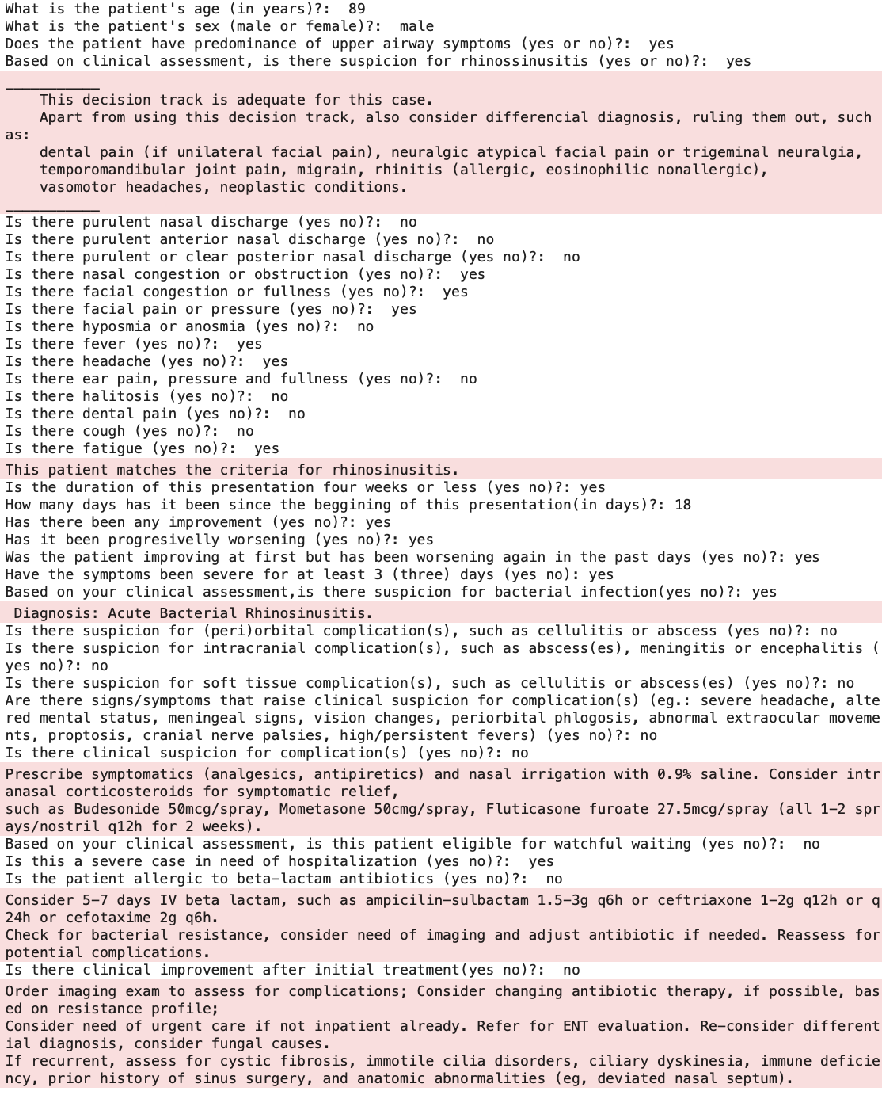
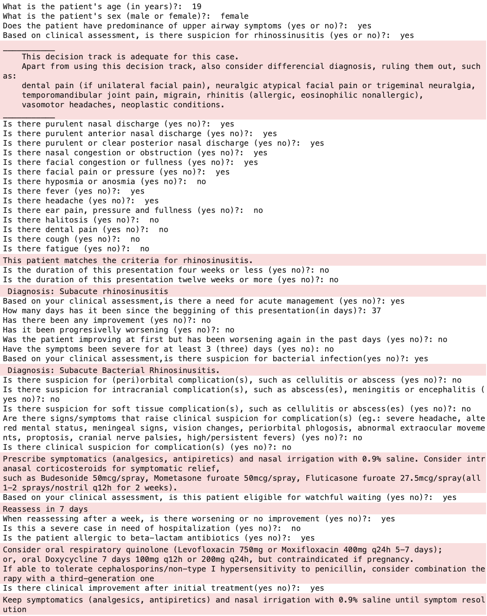
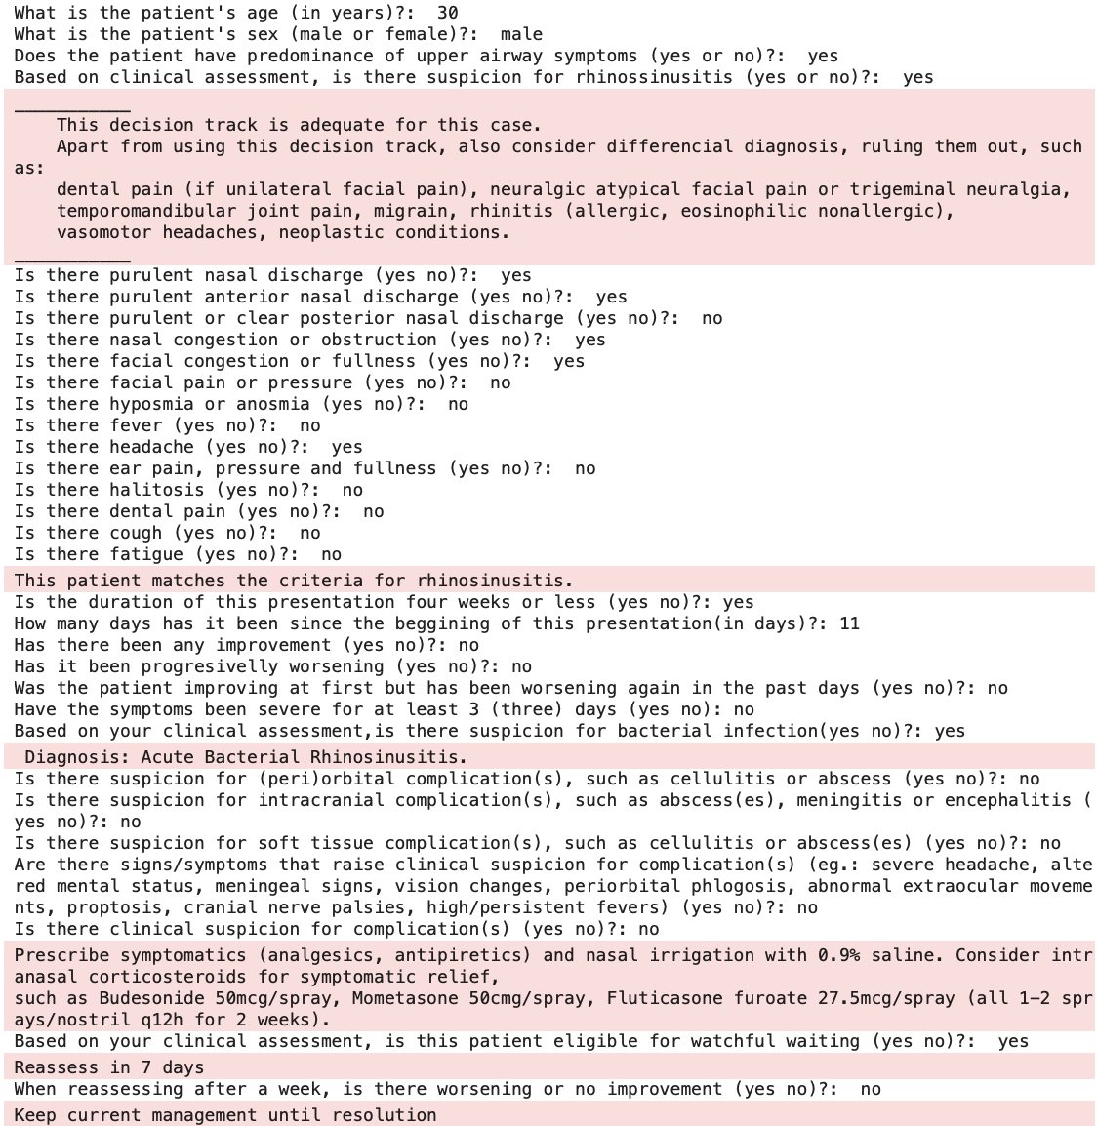
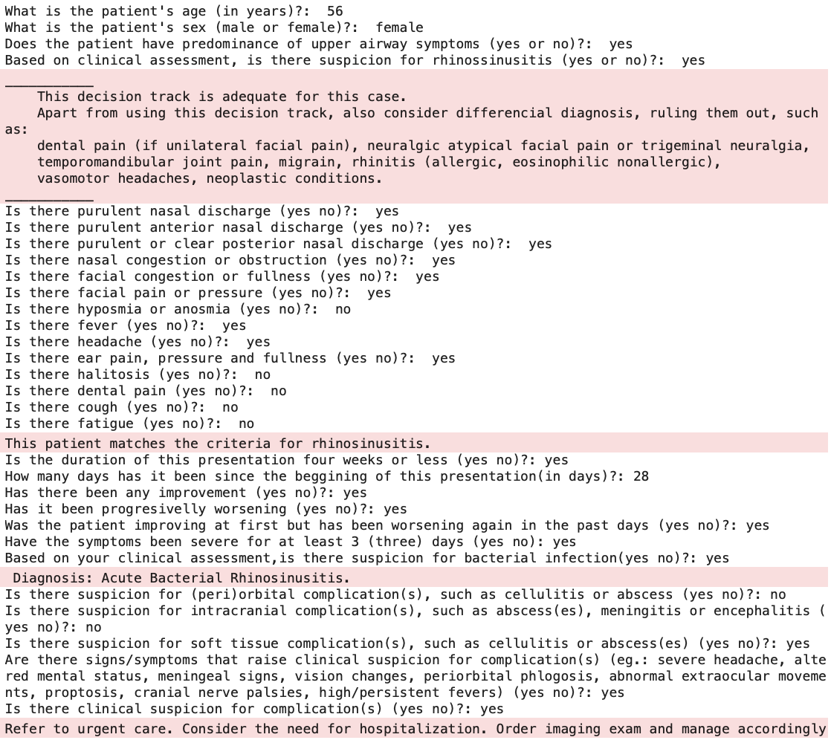
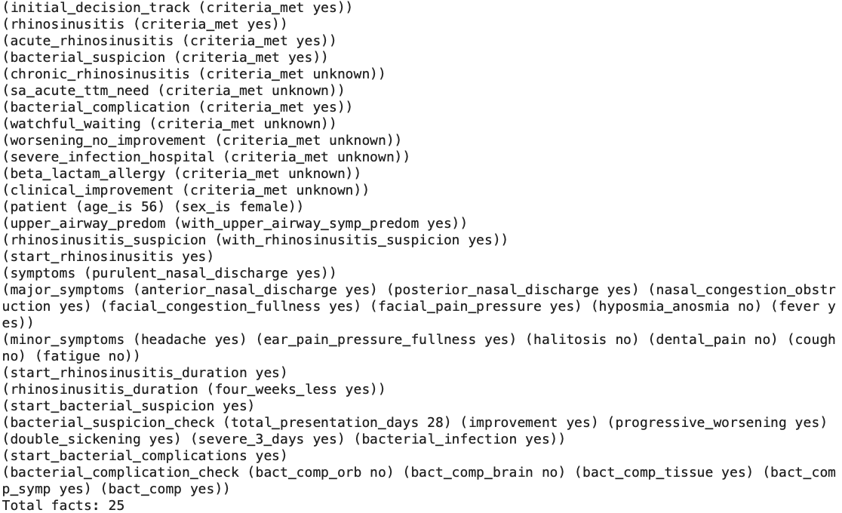
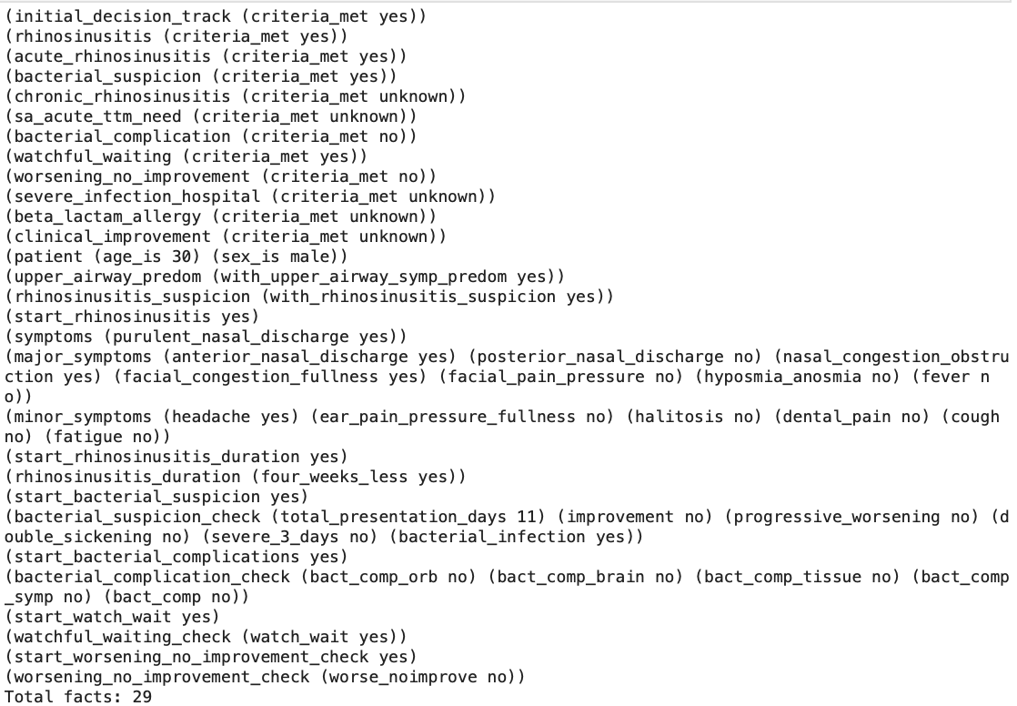
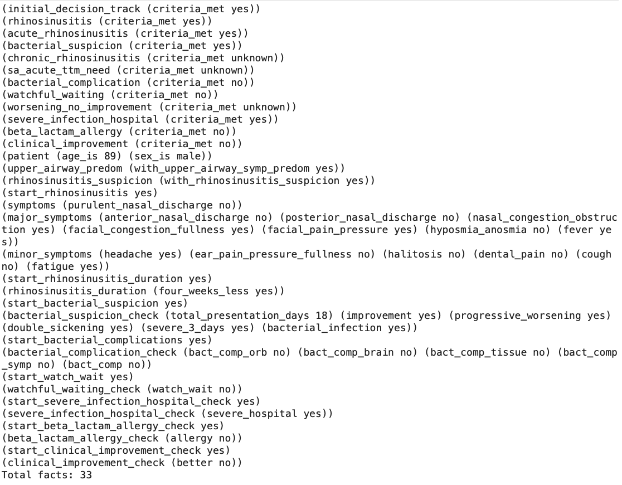
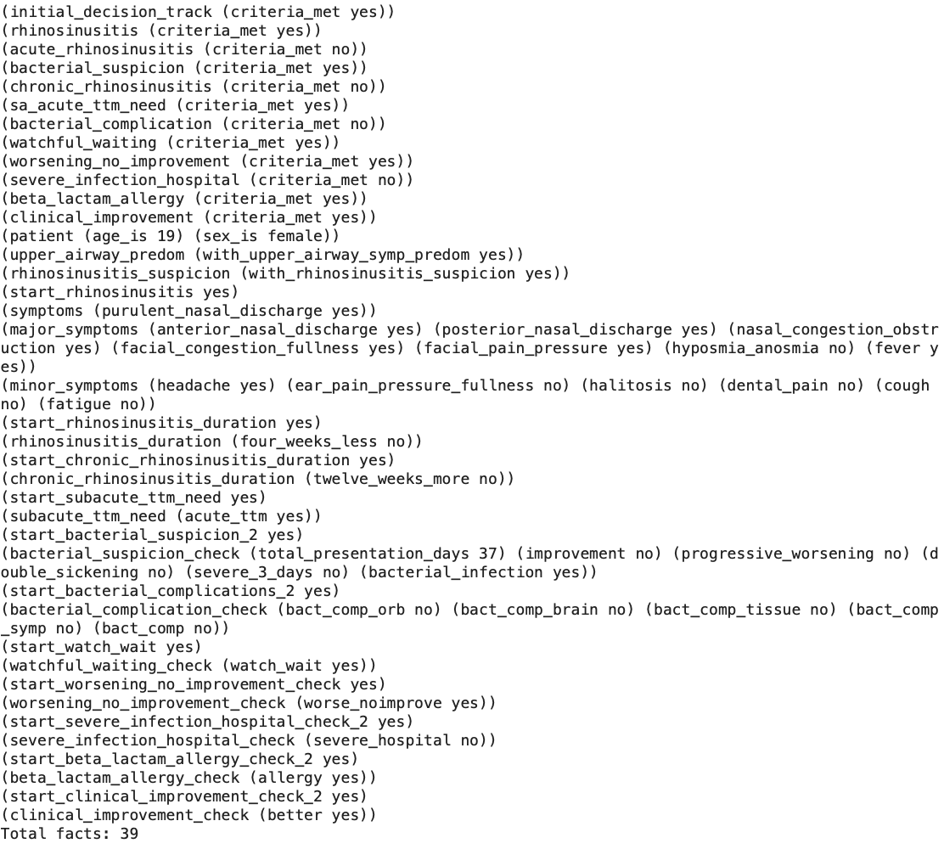
1
2
3
4

Slide 3
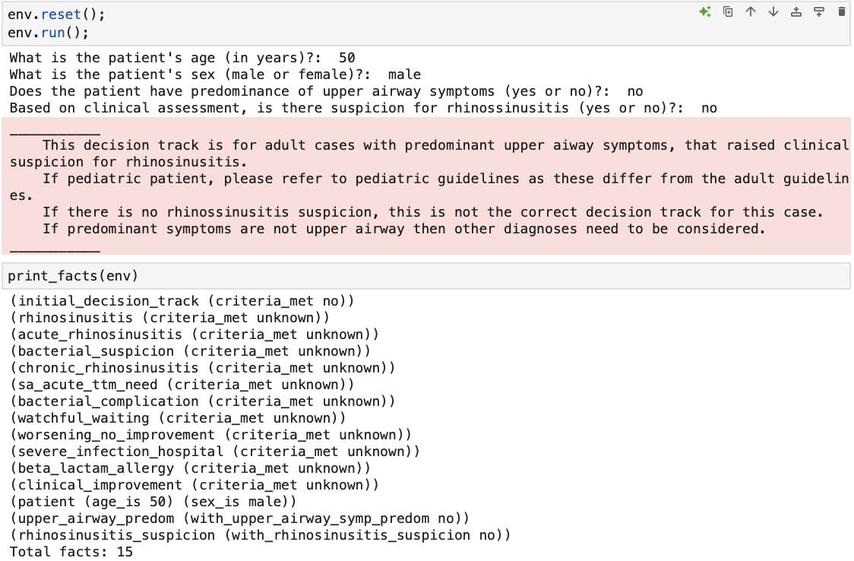
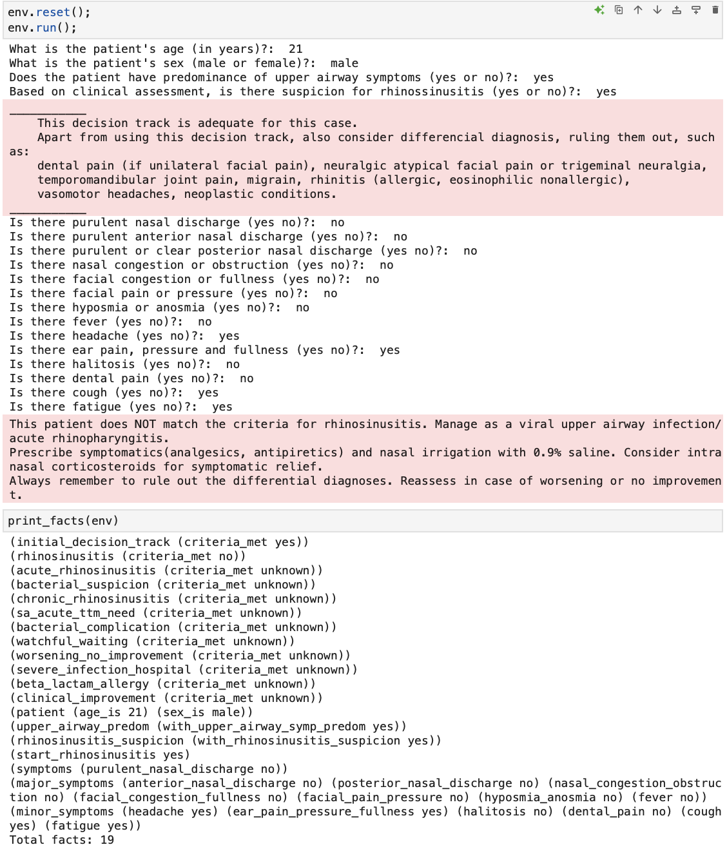
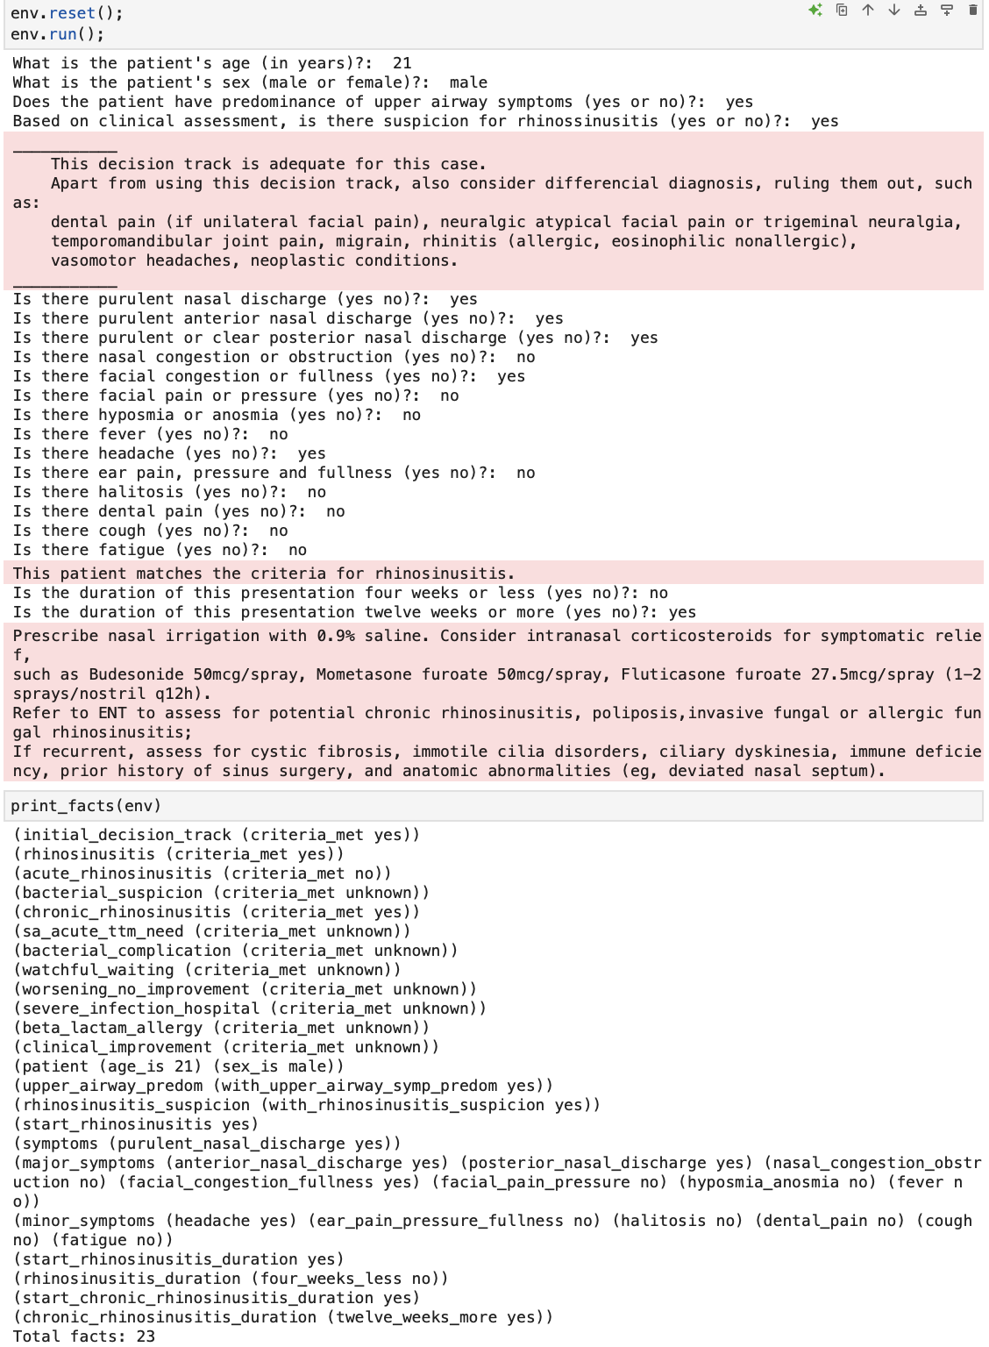
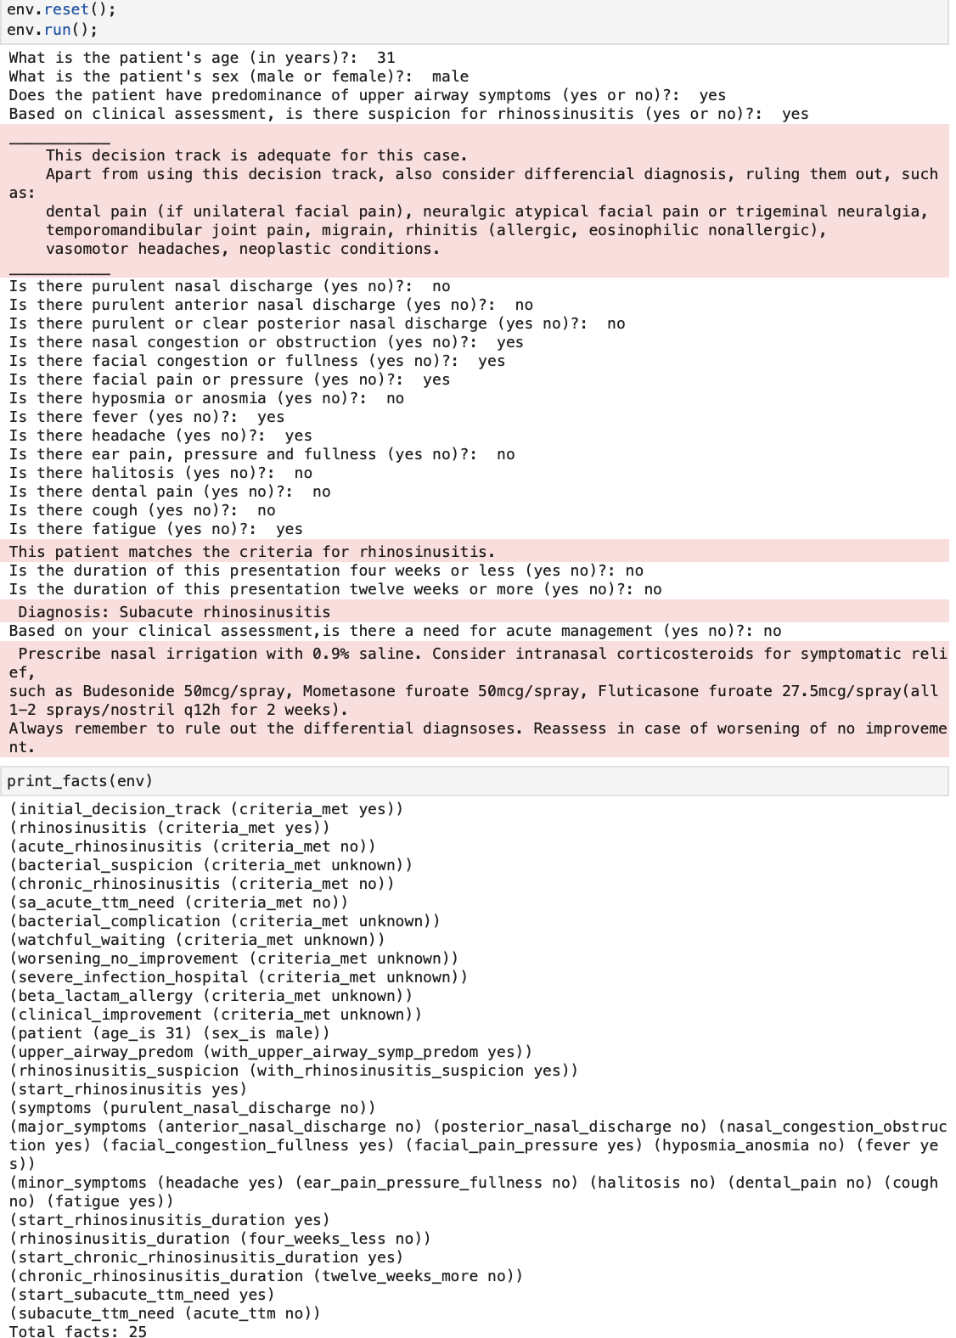
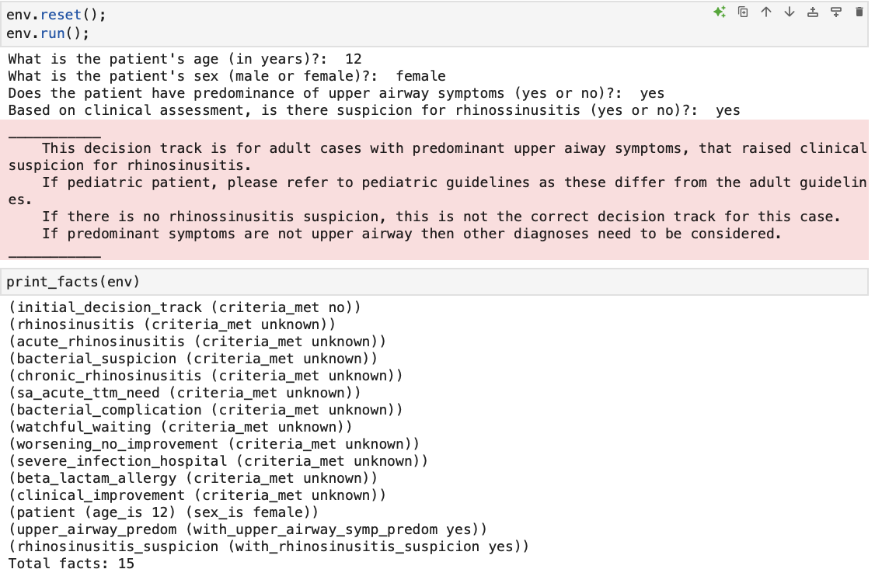
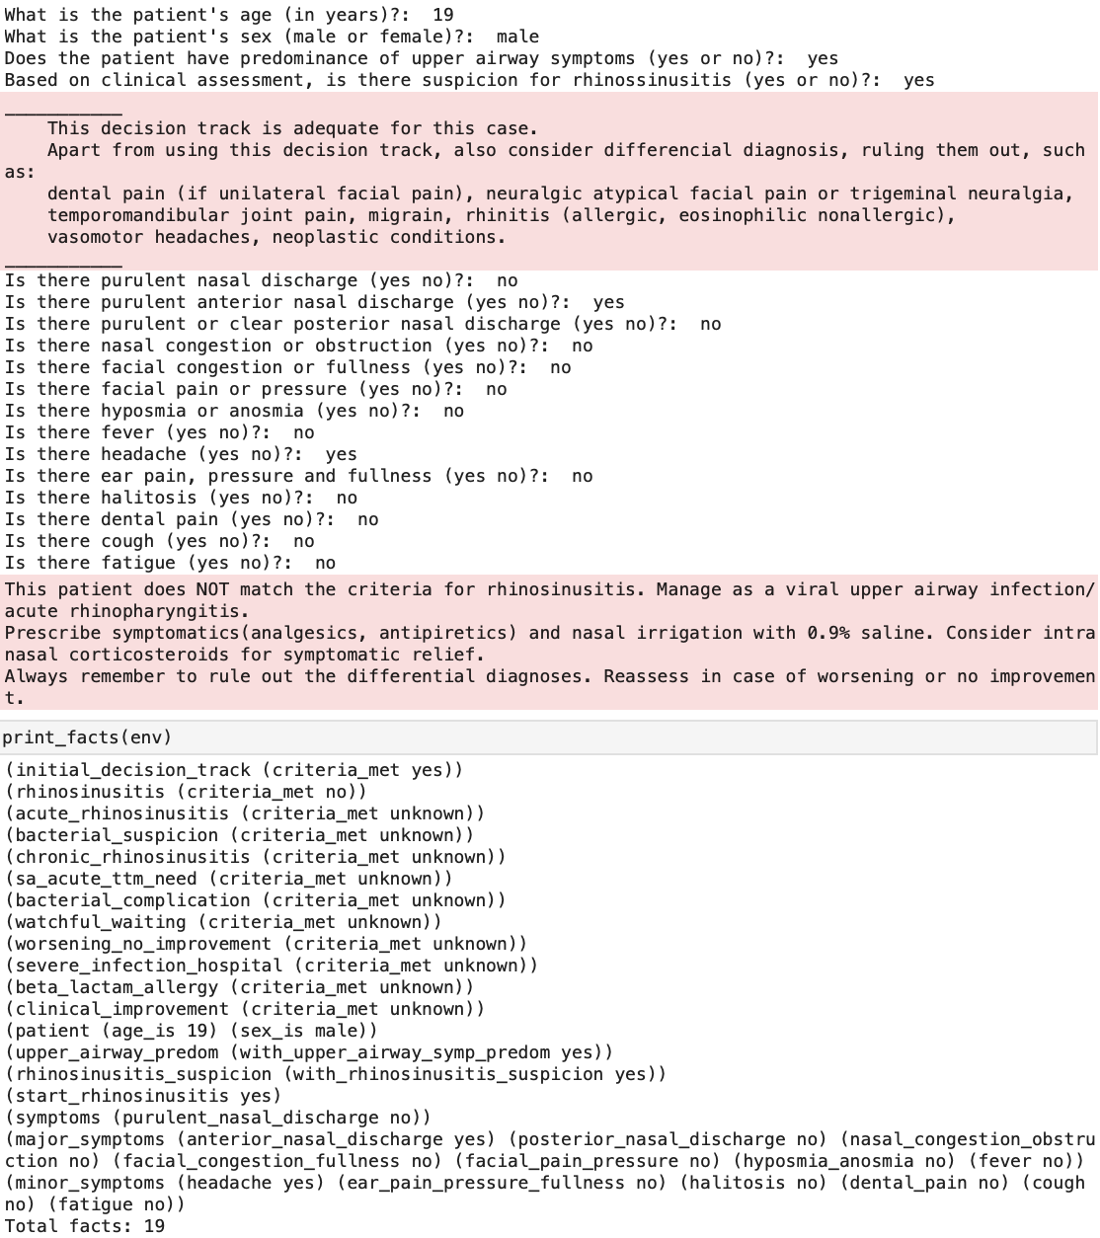
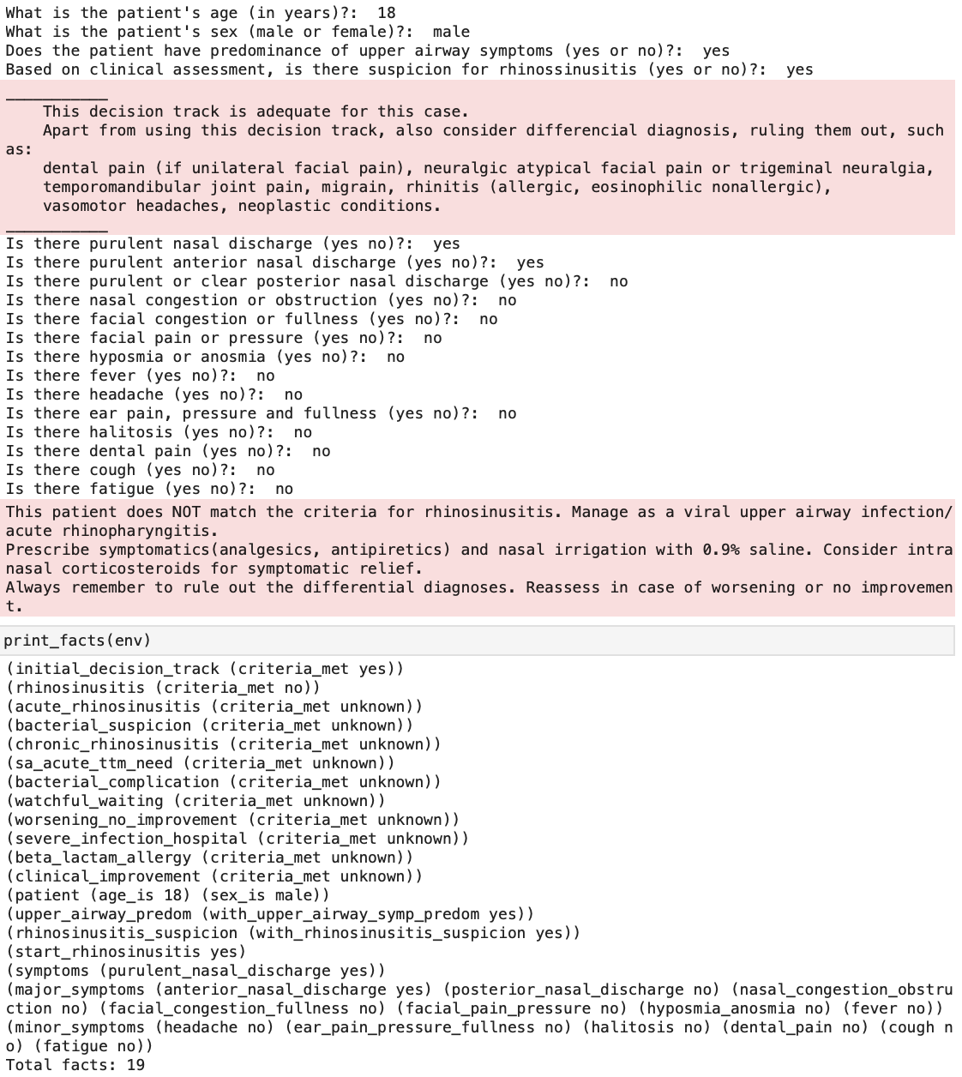
A
B
C
D
A
B
B
A: decision track not adequate for case
B: does not match rhinosinusitis criteria
C: chronic rhinosinusitis
D: subacute rhinosinusitis with no need of acute management
Notes:
Output examples:
A: decision track not adequate for case
B: does not match rhinosinusitis criteria
C: chronic rhinosinusitis
D: subacute rhinosinusitis with no need of acute management

Slide 4
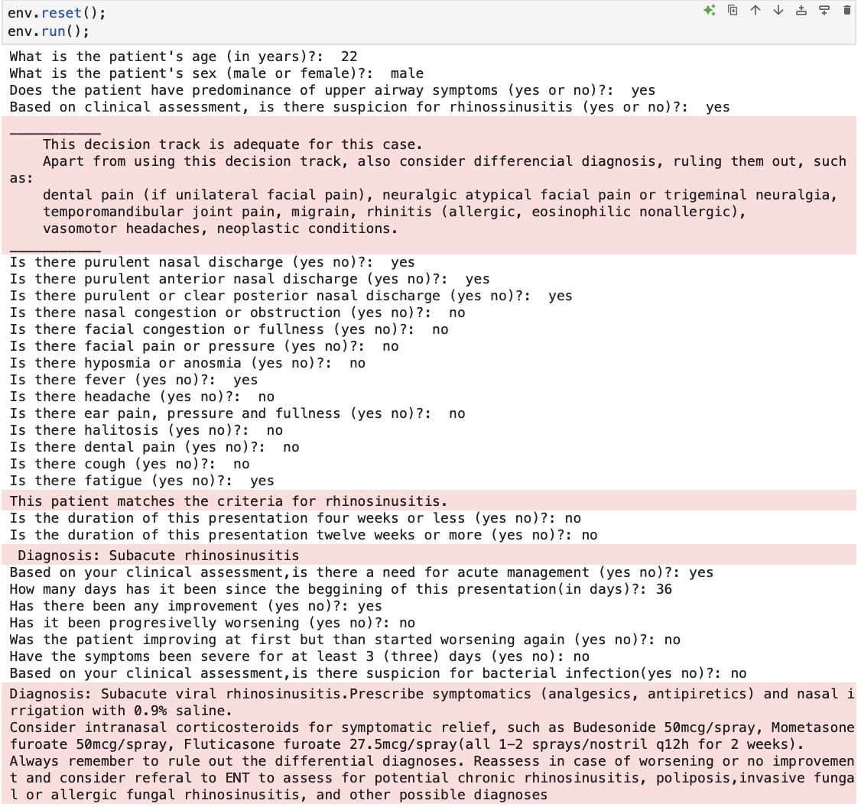
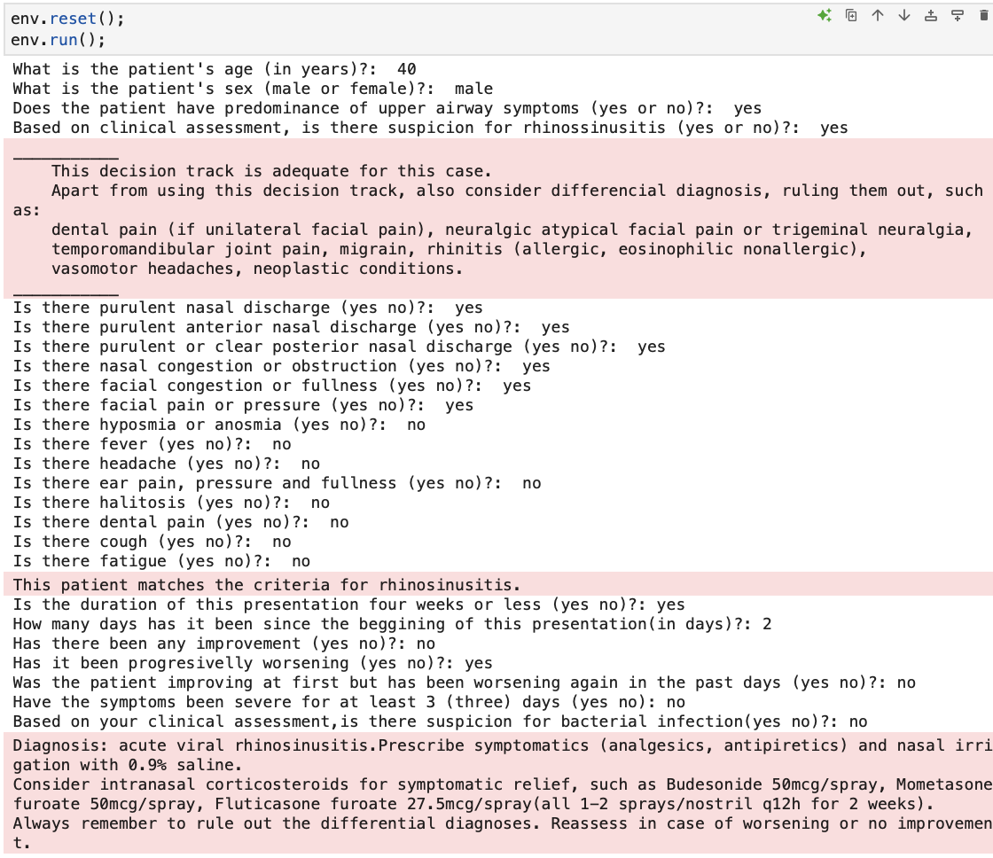
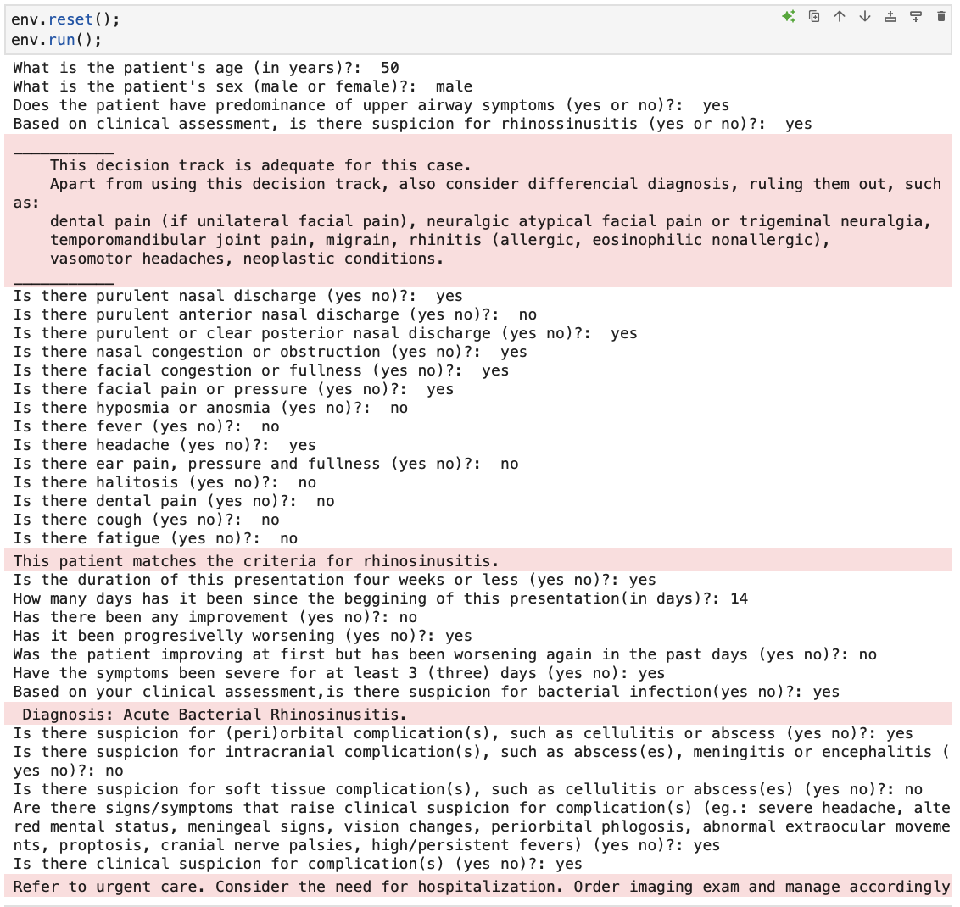
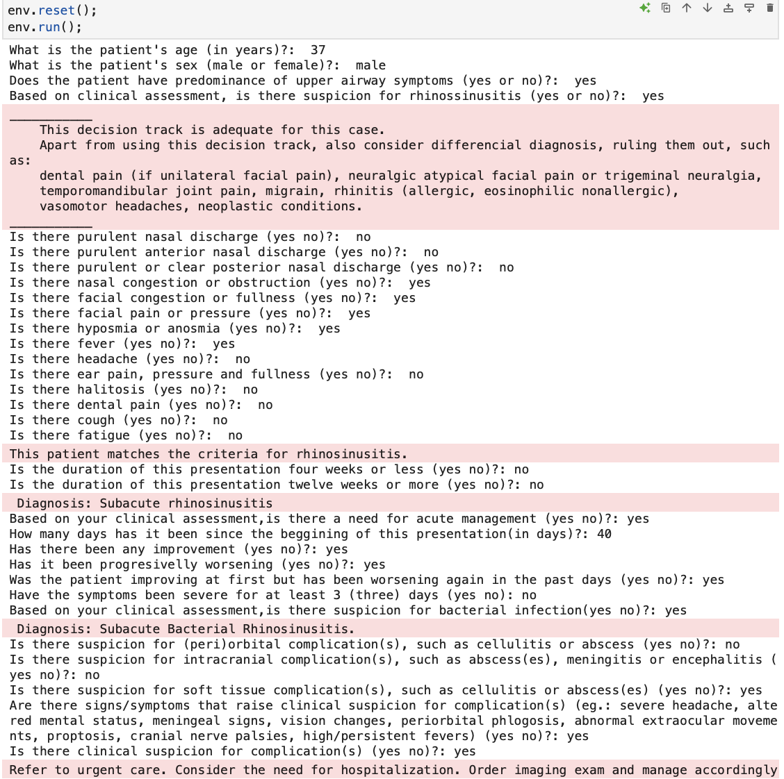
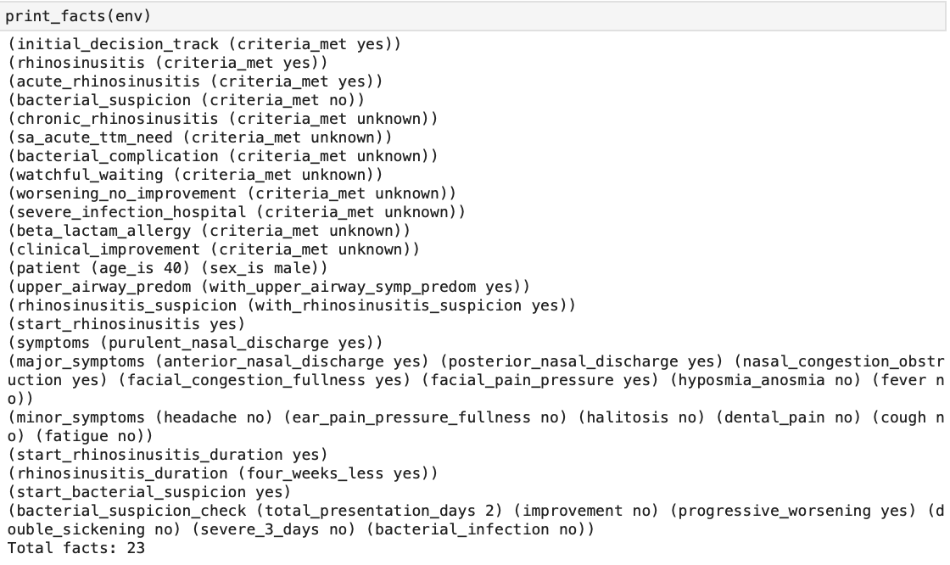
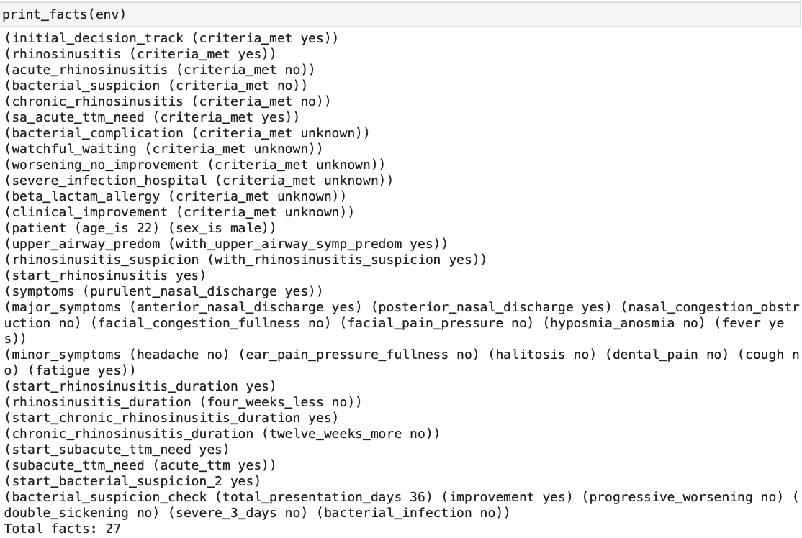
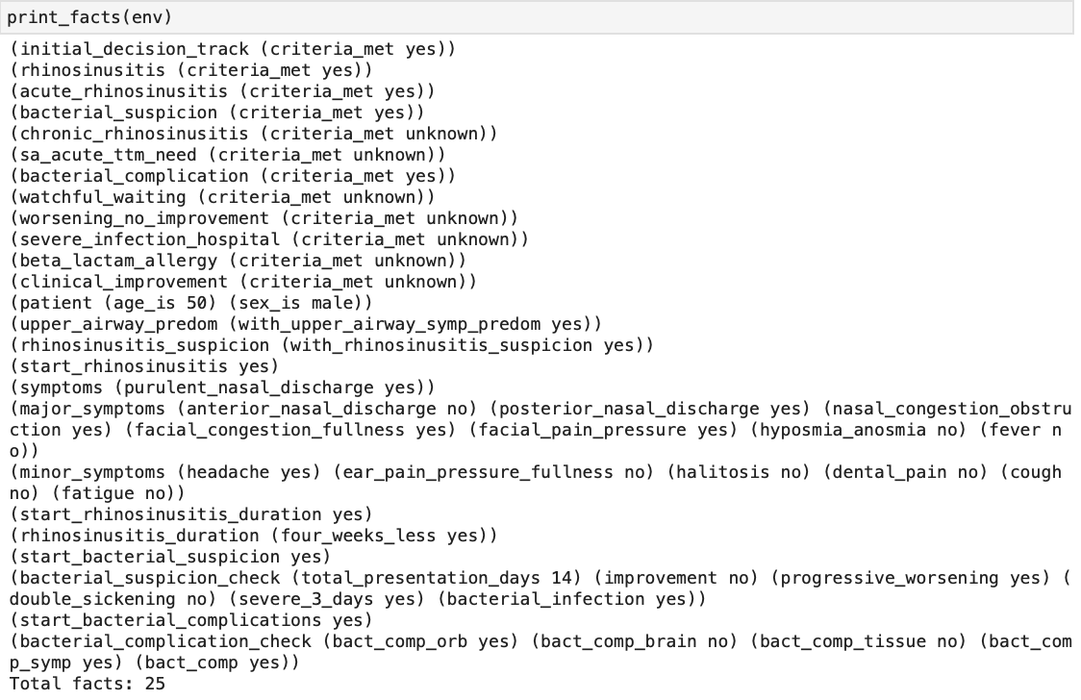
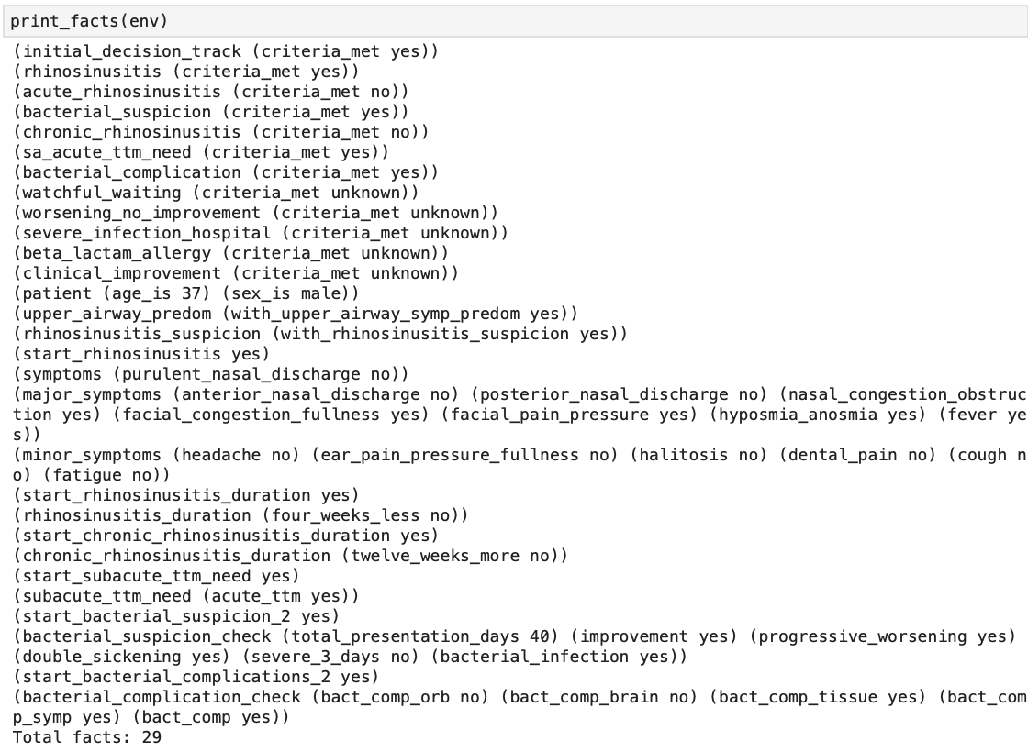
E
F
G
H
Output examples:
E: subacute viral rhinosinusitis
F: acute viral rhinosinusitis
G: complicated acute bacterial rhinosinusitis
H: complicated subacute bacterial rhinosinusitis
Notes:
Output examples:
E: subacute viral rhinosinusitis
F: acute viral rhinosinusitis
G: complicated acute bacterial rhinosinusitis
H: complicated subacute bacterial rhinosinusitis

Slide 5
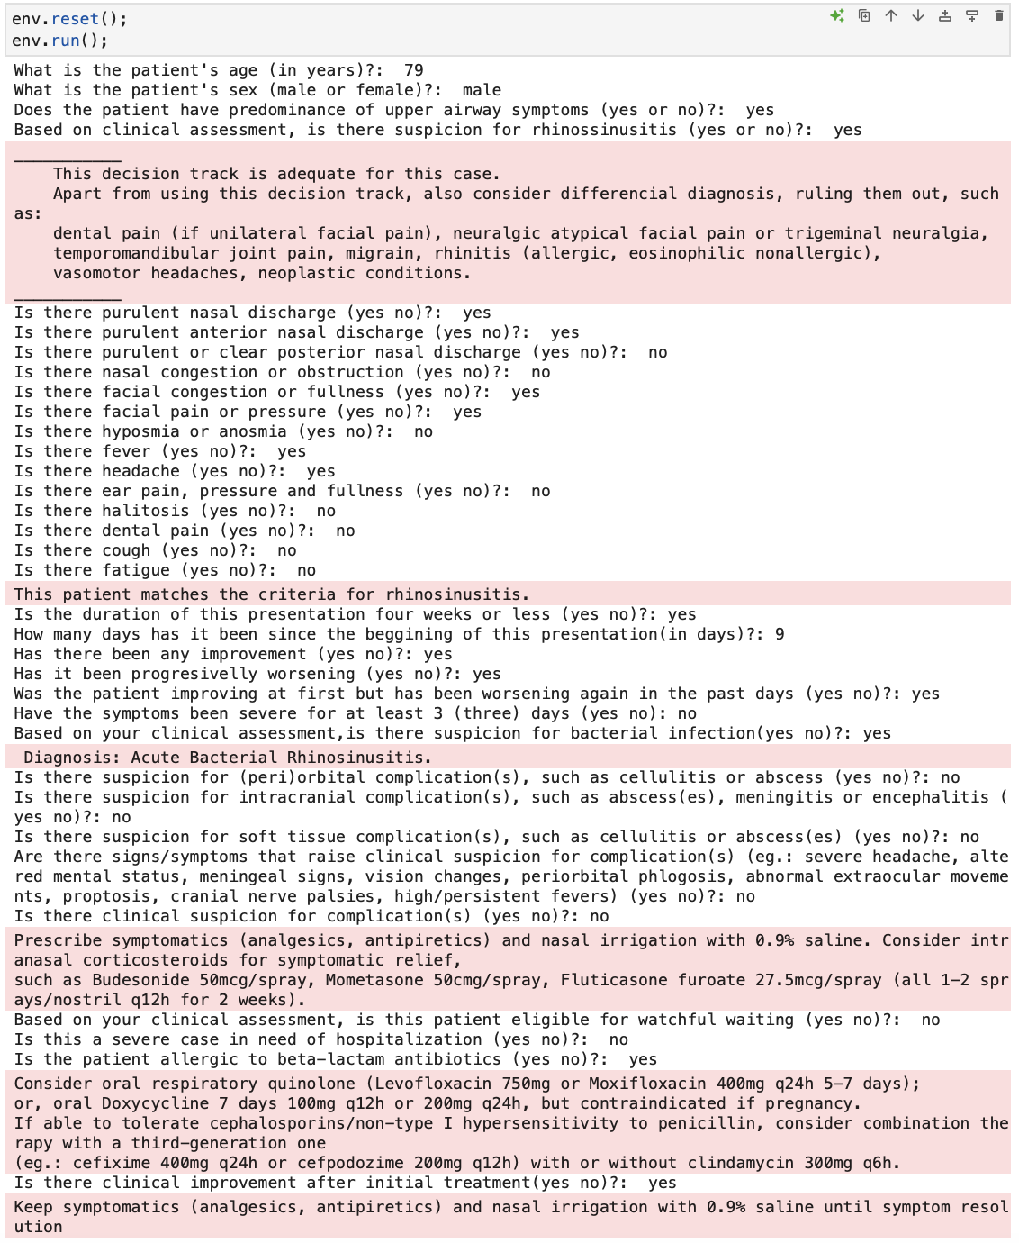
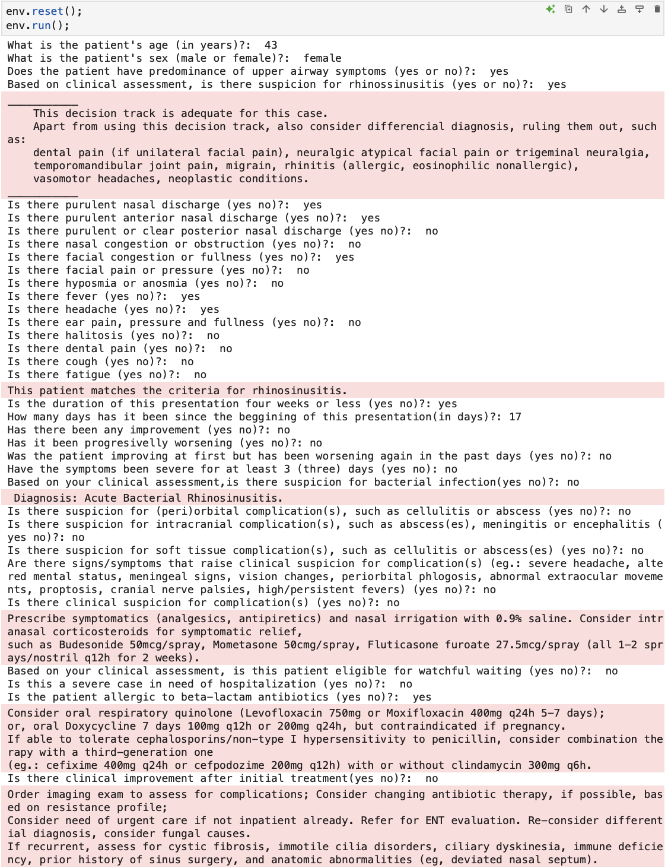
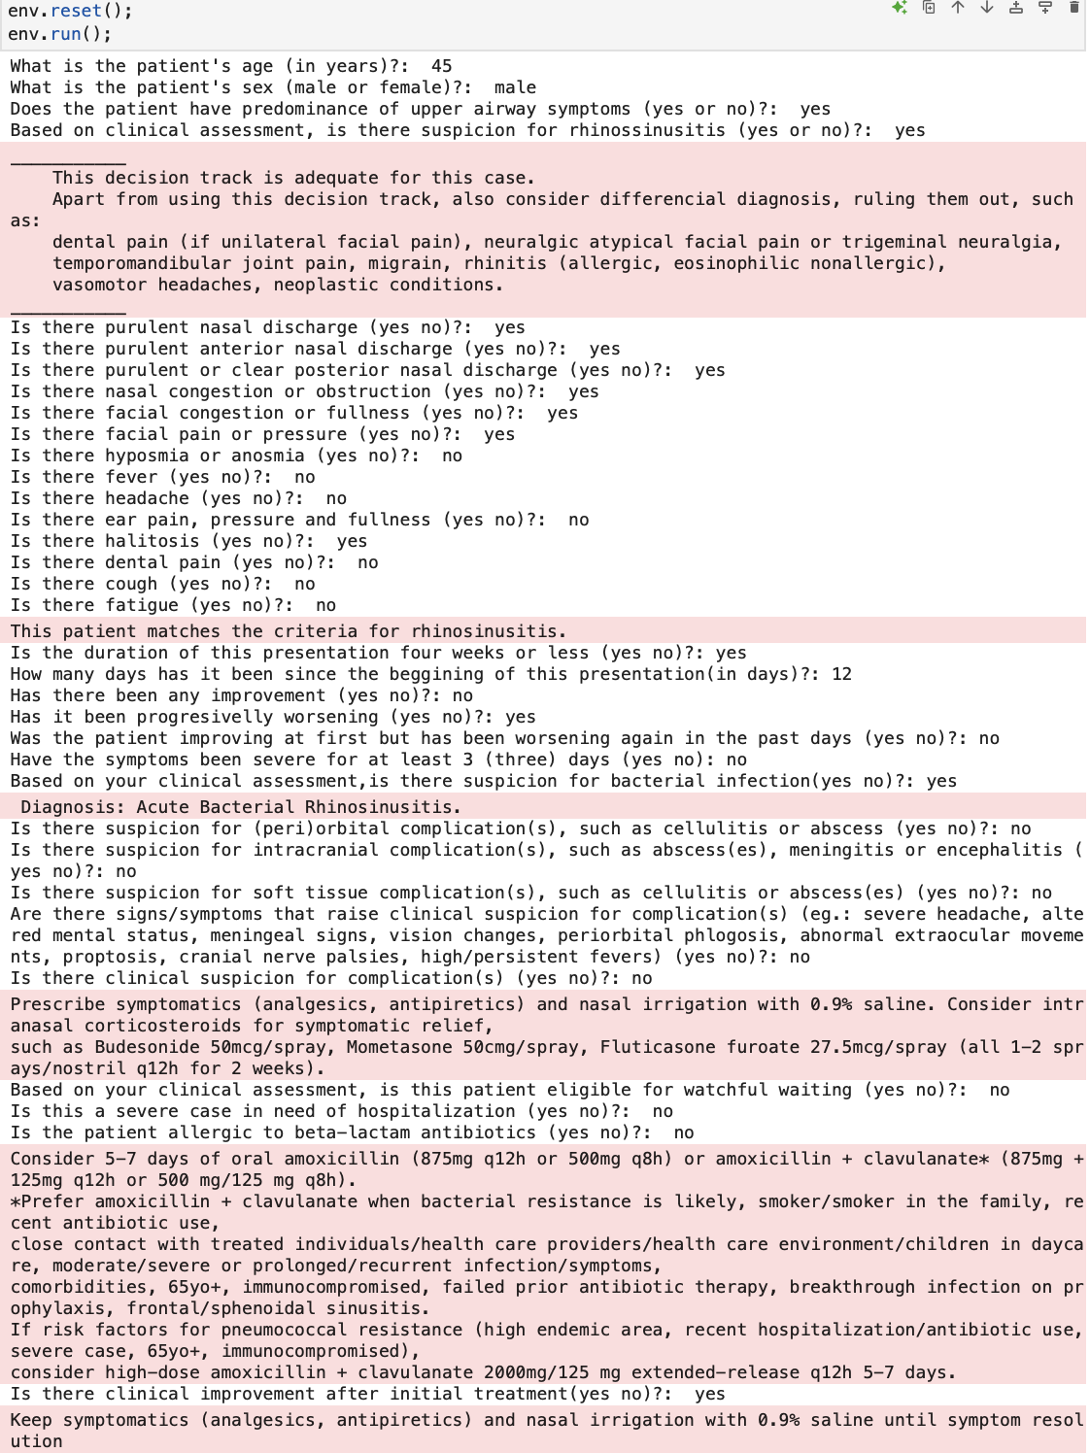
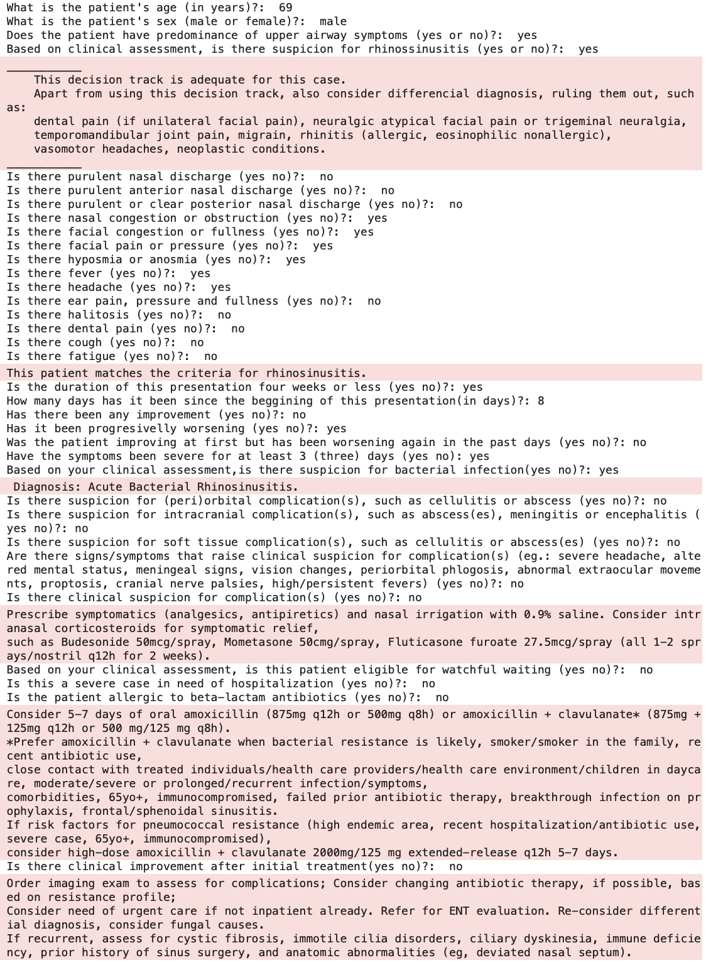
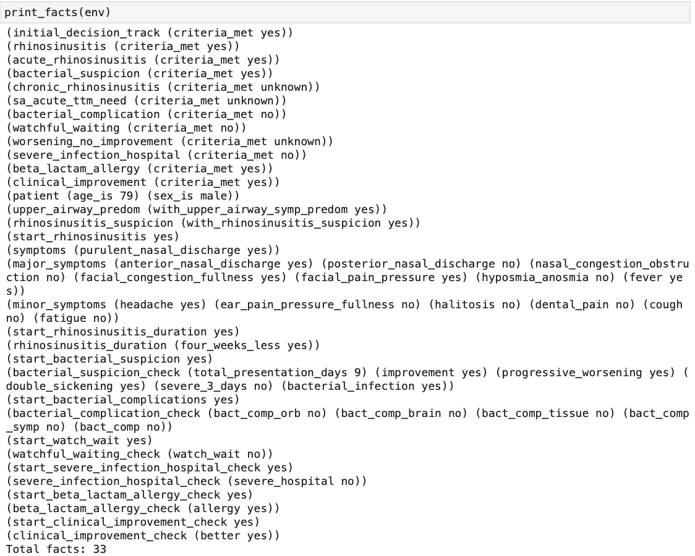
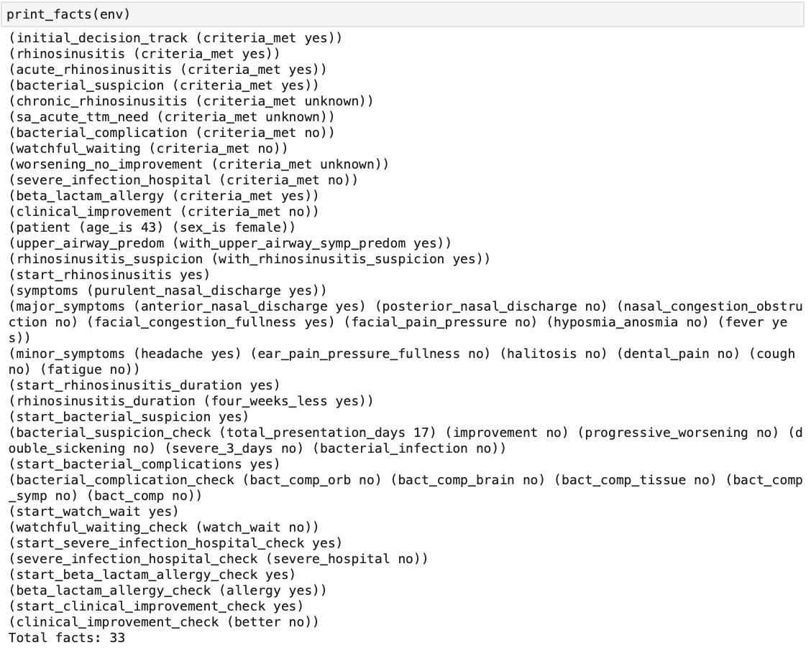
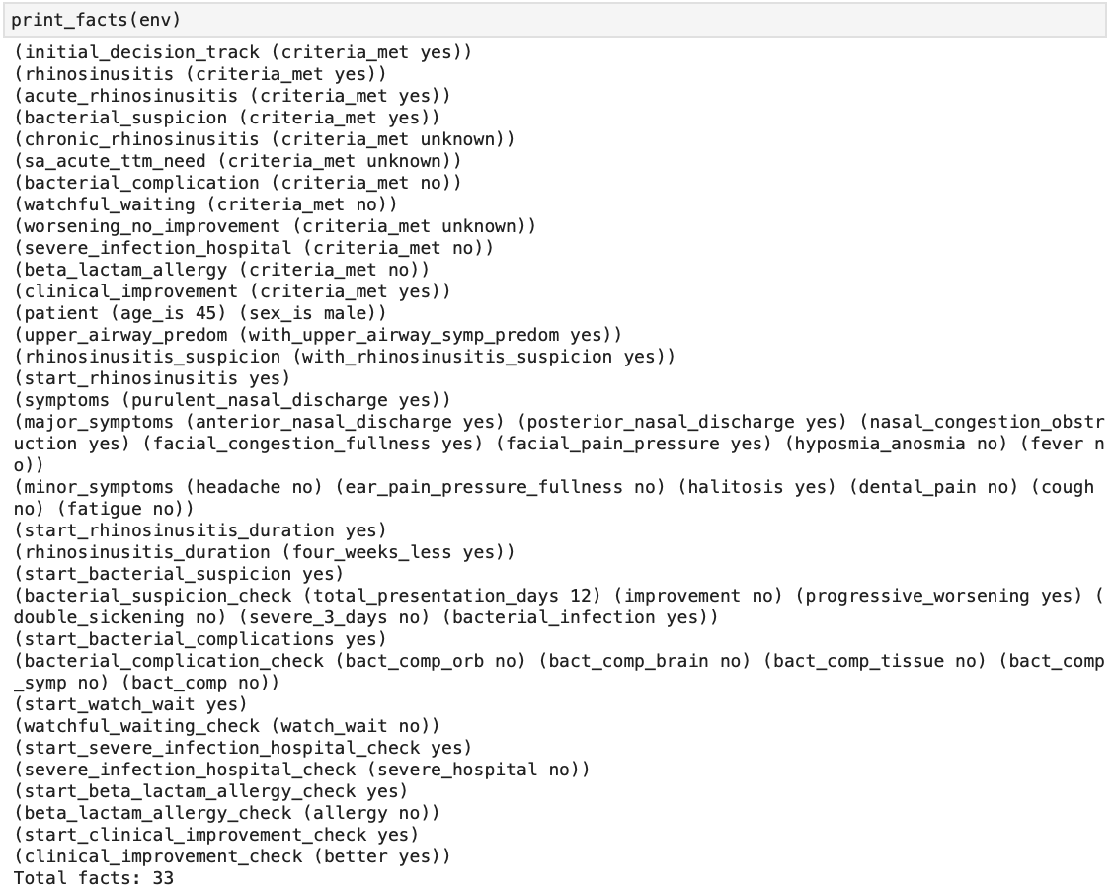
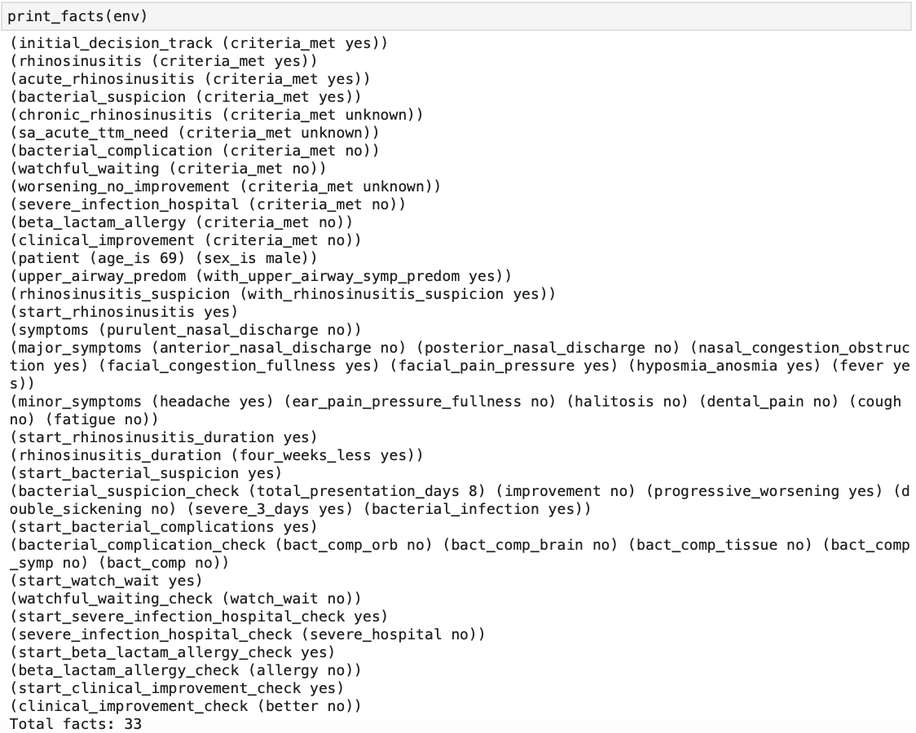
I
J
K
L
non-complicated outpatient ABRS
w/ beta-lactam allergy and
clinical improvement
post initial treatment
non-complicated outpatient ABRS
w/ beta-lactam allergy and
no clinical improvement
post initial treatment
non-complicated outpatient ABRS
w/o beta-lactam allergy and
w/ clinical improvement
post initial treatment
non-complicated outpatient ABRS
w/o beta-lactam allergy and
no clinical improvement
post initial treatment
Notes:
Output examples:
I: non-complicated outpatient ABRS w/ beta-lactam allergy and clinical improvement post initial treatment
J: non-complicated outpatient ABRS w/ beta-lactam allergy and no clinical improvement post initial treatment
K: non-complicated outpatient ABRS w/o beta-lactam allergy and w/ clinical improvement post initial treatment
L: non-complicated outpatient ABRS w/o beta-lactam allergy and no clinical improvement post initial treatment

Slide 6
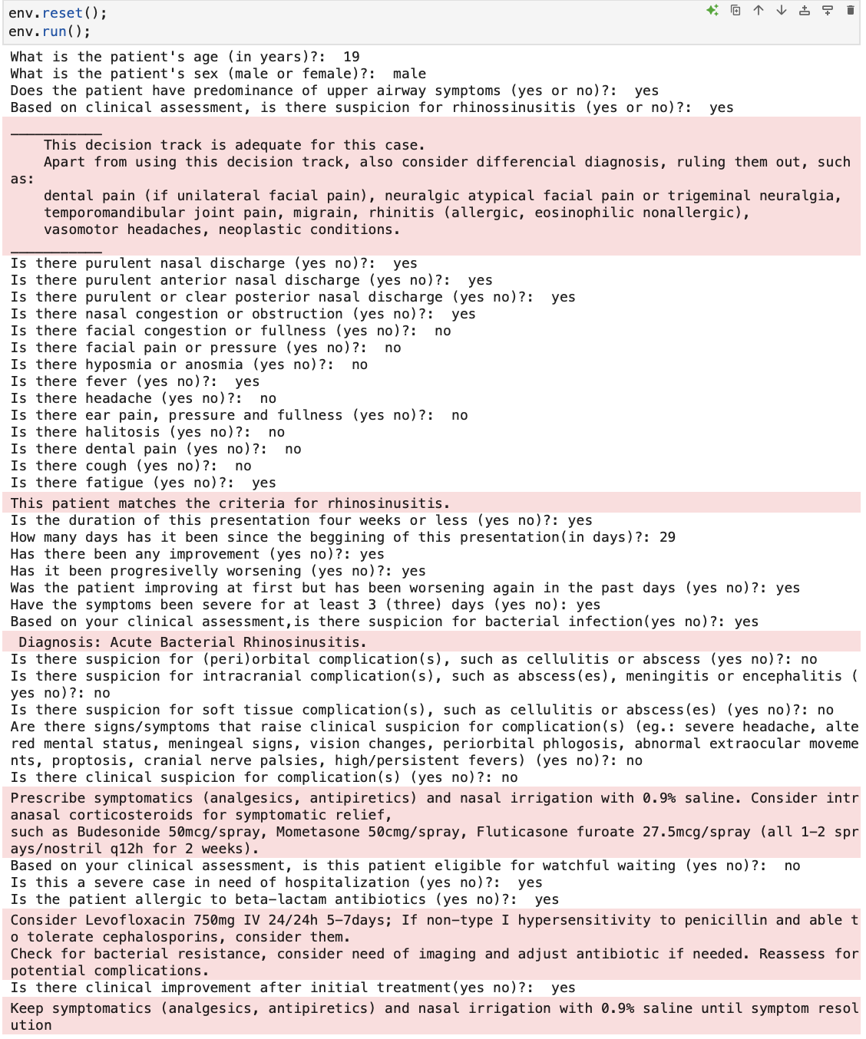
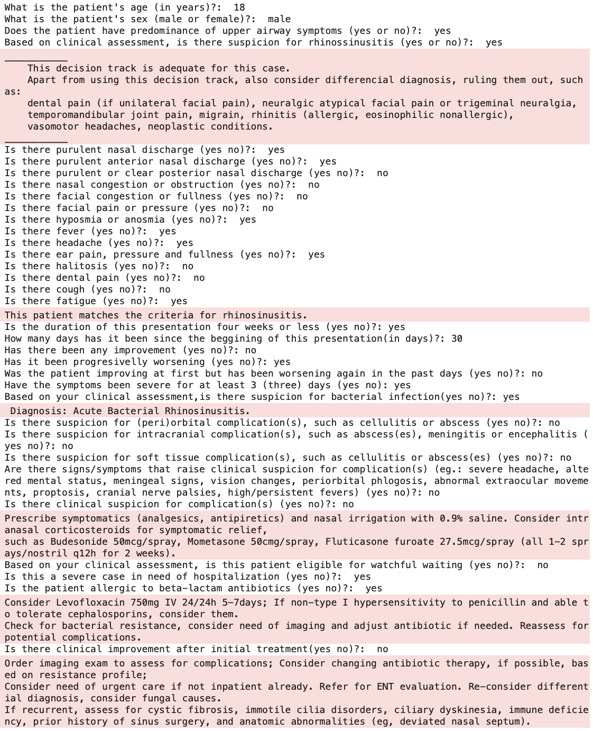
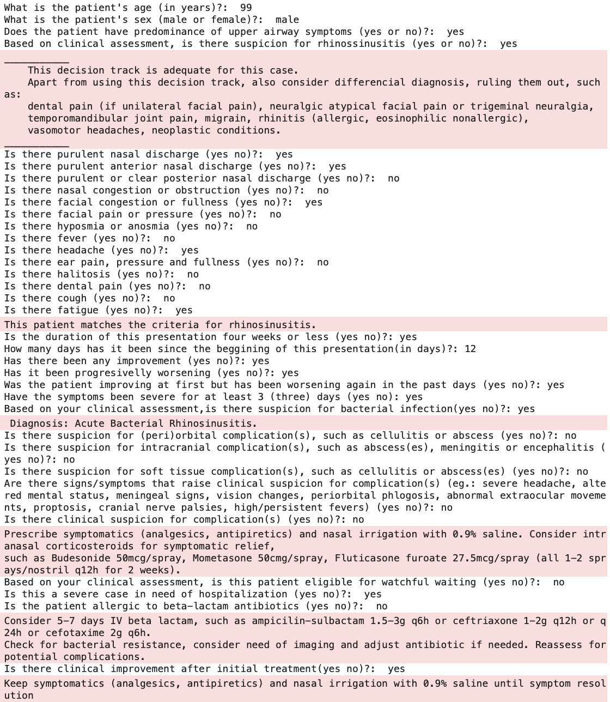
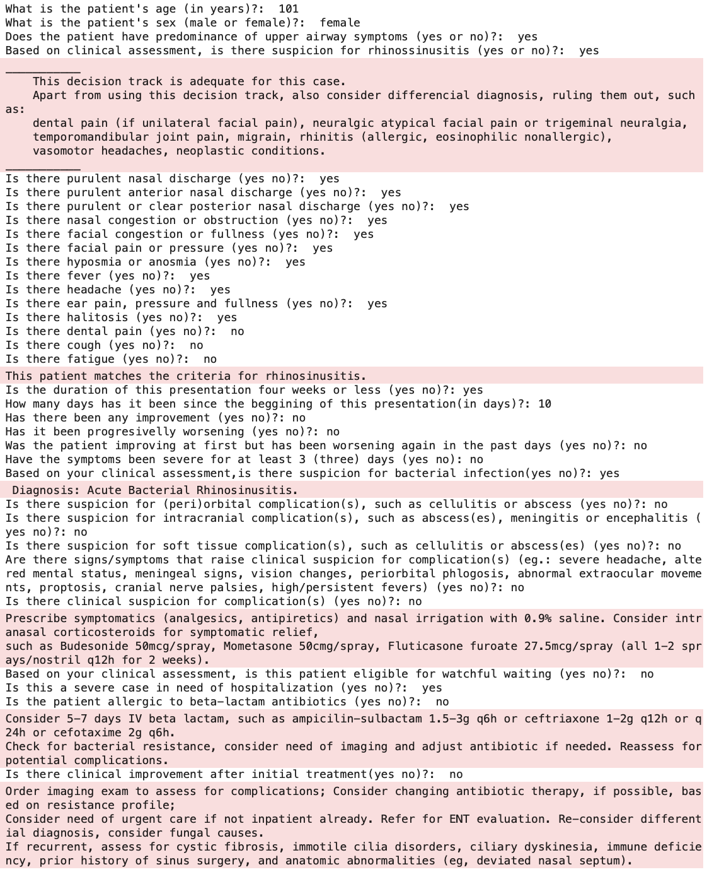

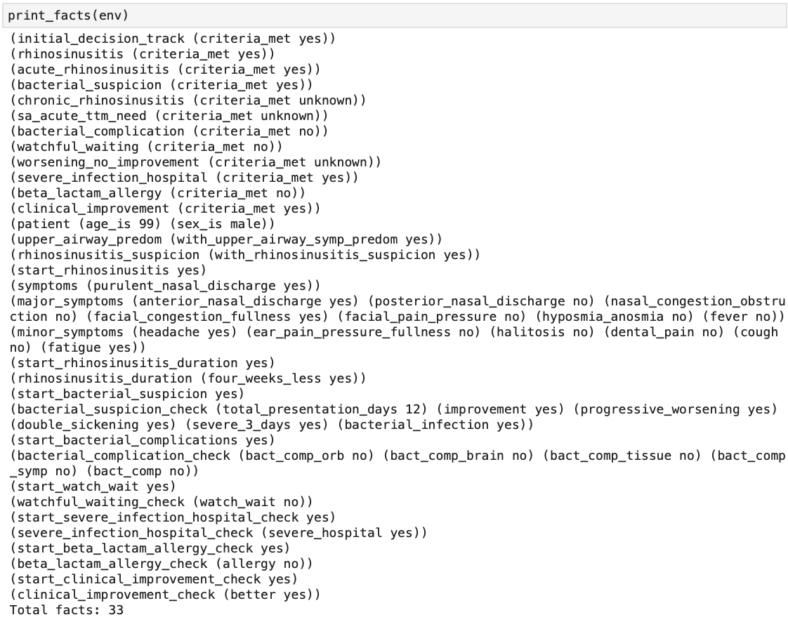
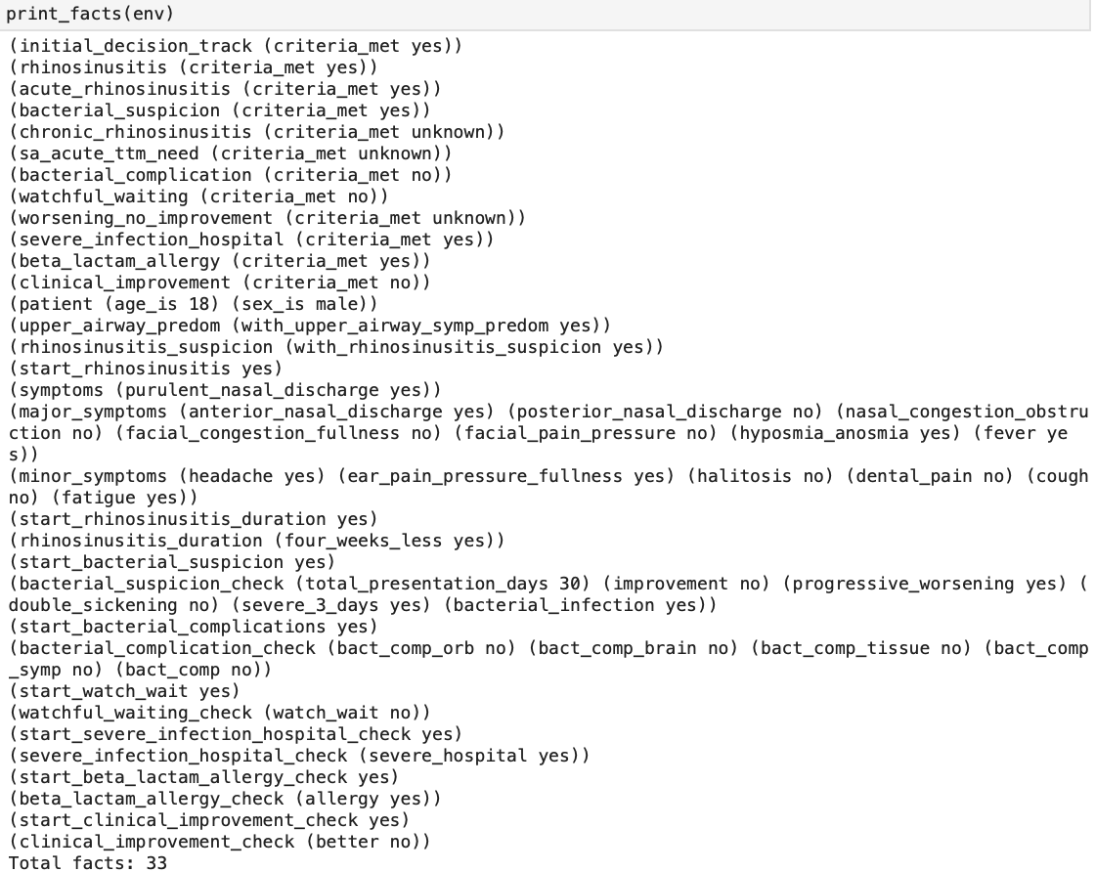
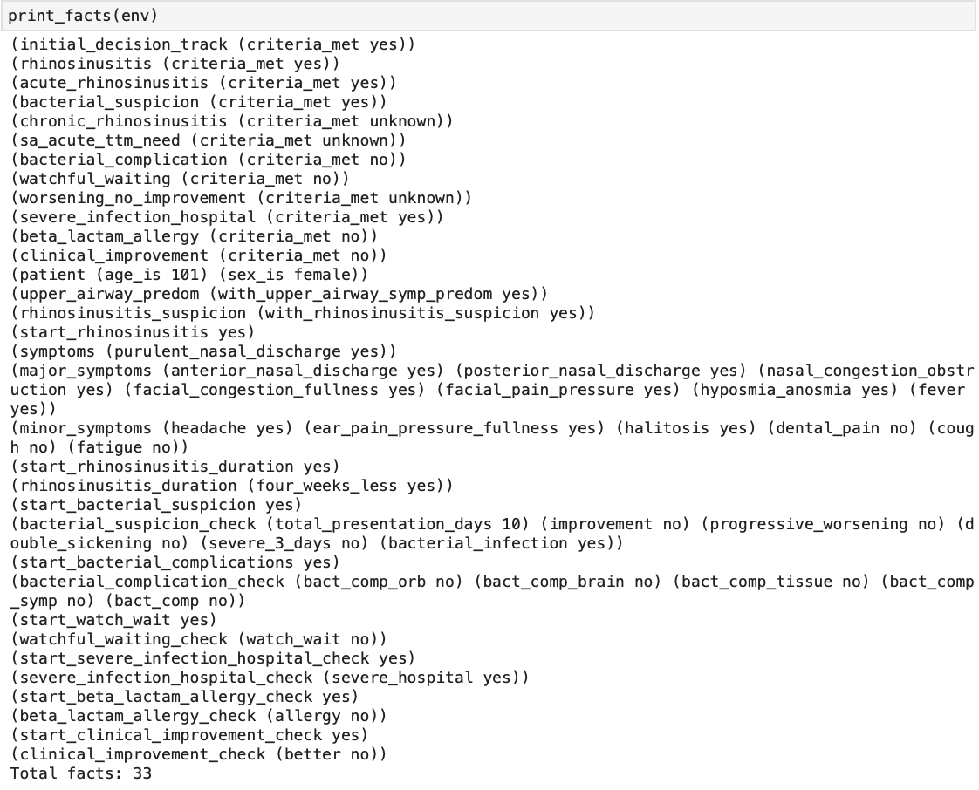
M
N
O
P
non-complicated inpatient ABRS
w/ beta-lactam allergy and
clinical improvement
post initial treatment
non-complicated inpatient ABRS
w/ beta-lactam allergy and
no clinical improvement
post initial treatment
non-complicated inpatient ABRS
w/o beta-lactam allergy and
w/ clinical improvement
post initial treatment
non-complicated inpatient ABRS
w/o beta-lactam allergy and
no clinical improvement
post initial treatment
Notes:
Output examples:
M: non-complicated inpatient ABRS w/ beta-lactam allergy and clinical improvement post initial treatment
N: non-complicated inpatient ABRS w/ beta-lactam allergy and no clinical improvement post initial treatment
O: non-complicated inpatient ABRS w/o beta-lactam allergy and w/ clinical improvement post initial treatment
P: non-complicated inpatient ABRS w/o beta-lactam allergy and no clinical improvement post initial treatment

Slide 7
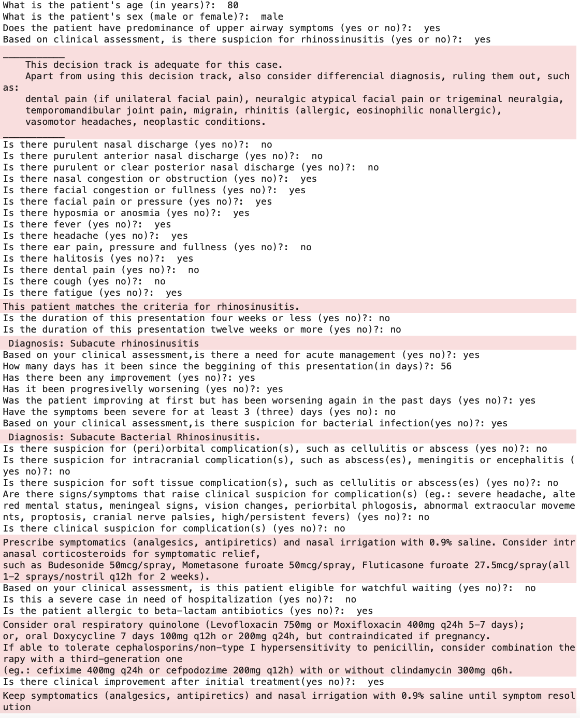
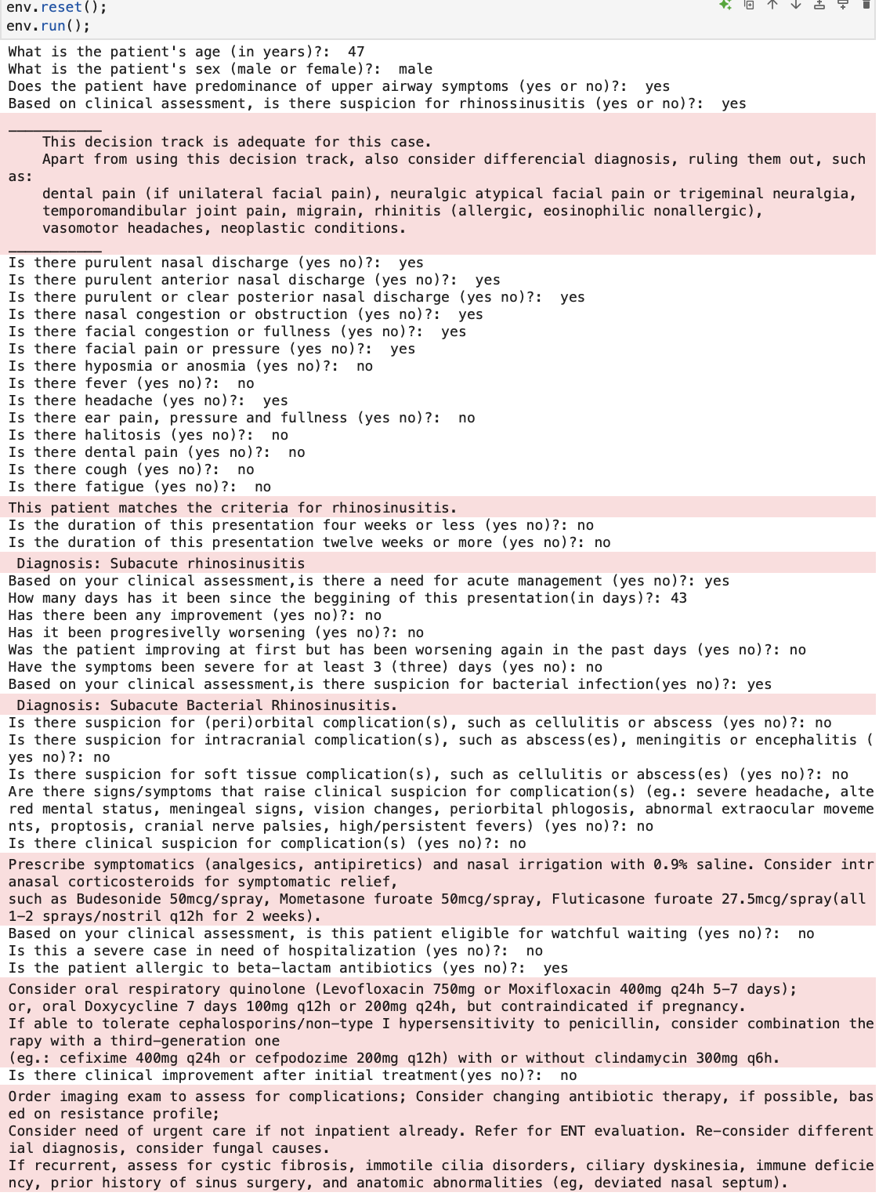
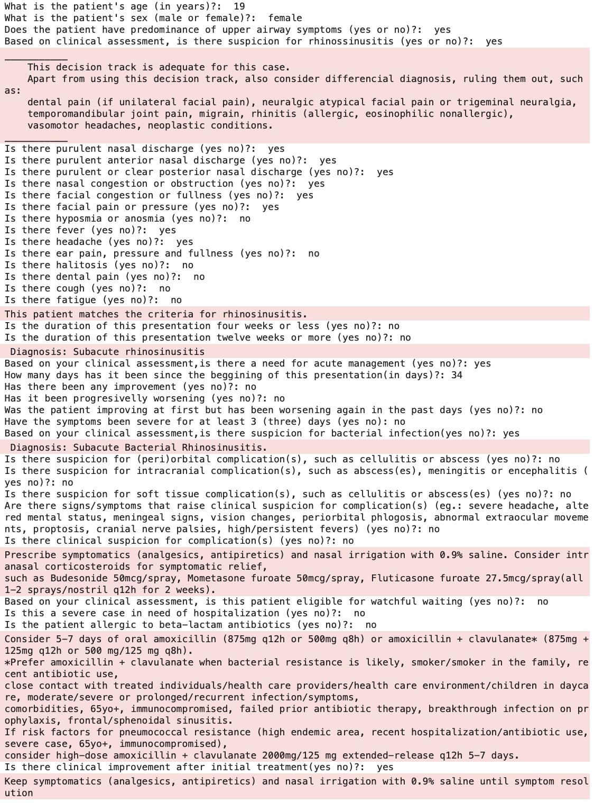
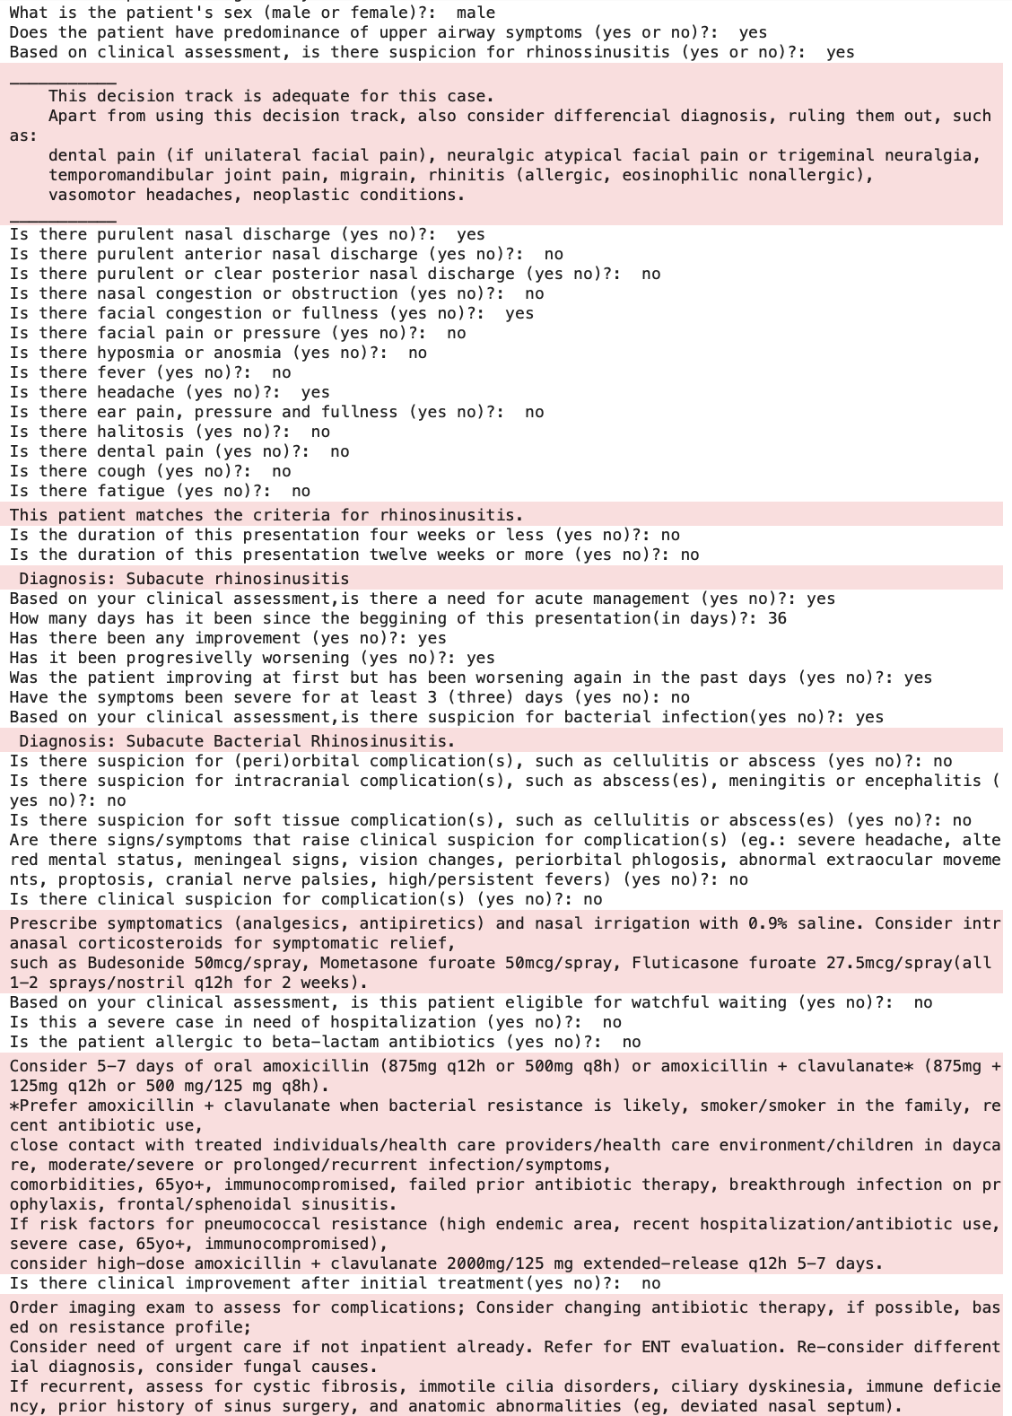
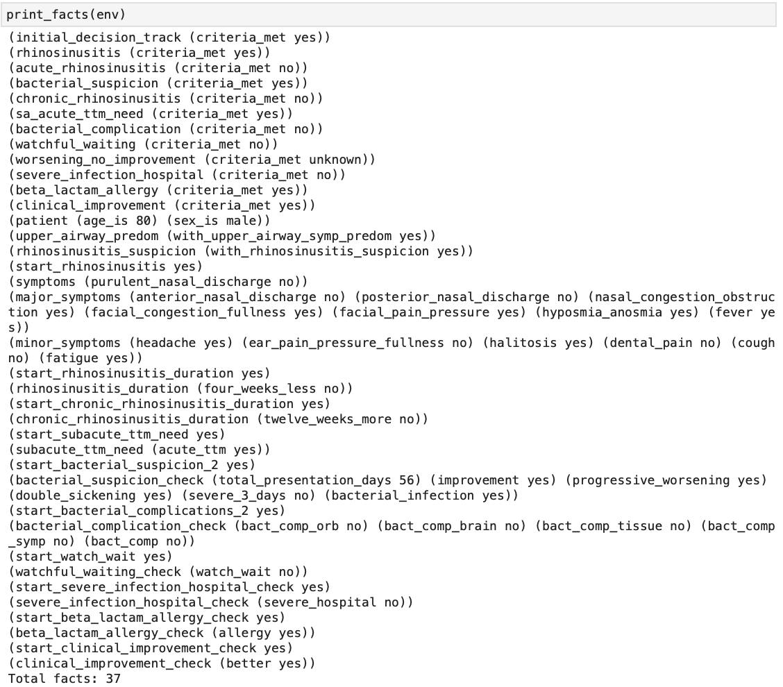

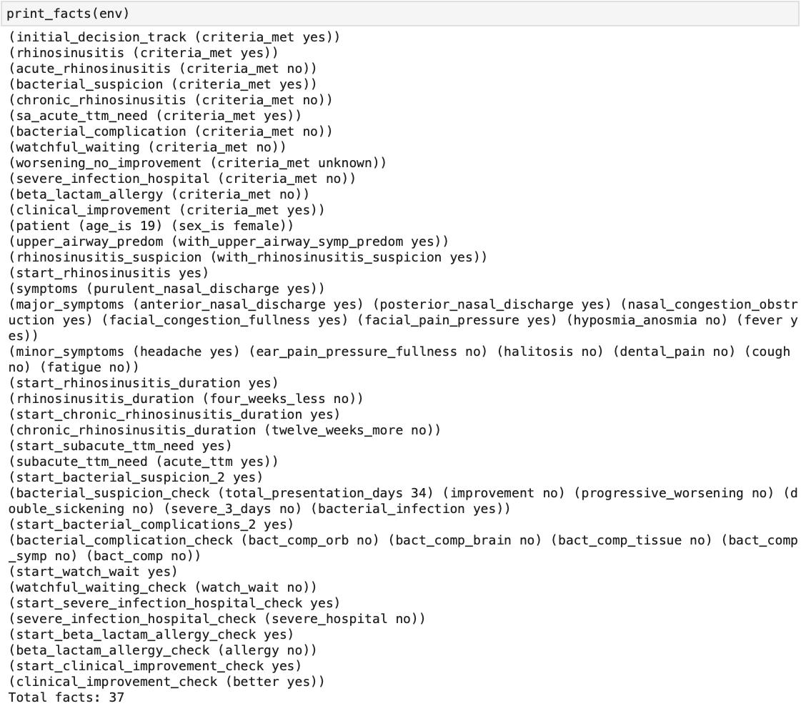
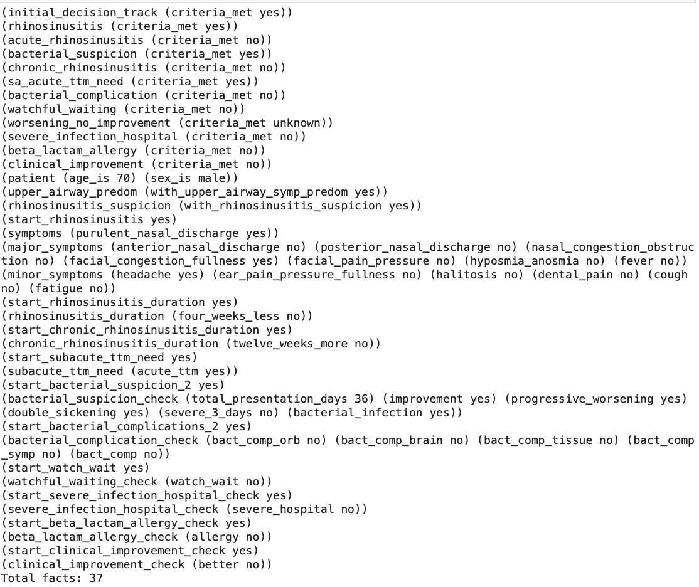
Q
R
S
T
non-complicated outpatient SABRS w/ beta-lactam allergy and clinical improvement post initial treatment
non-complicated outpatient SABRS w/ beta-lactam allergy
and no clinical improvement post initial treatment
non-complicated outpatient SABRS w/o beta-lactam
allergy and w/ clinical improvement post initial treatment
non-complicated outpatient SABRS w/o beta-lactam
allergy and no clinical improvement post initial treatment
Notes:
Output examples:
Q: non-complicated outpatient SABRS w/ beta-lactam allergy and clinical improvement post initial treatment R: non-complicated outpatient SABRS w/ beta-lactam allergy and no clinical improvement post initial treatment
S: non-complicated outpatient SABRS w/o beta-lactam allergy and w/ clinical improvement post initial treatment
T: non-complicated outpatient SABRS w/o beta-lactam allergy and no clinical improvement post initial treatment

Slide 8
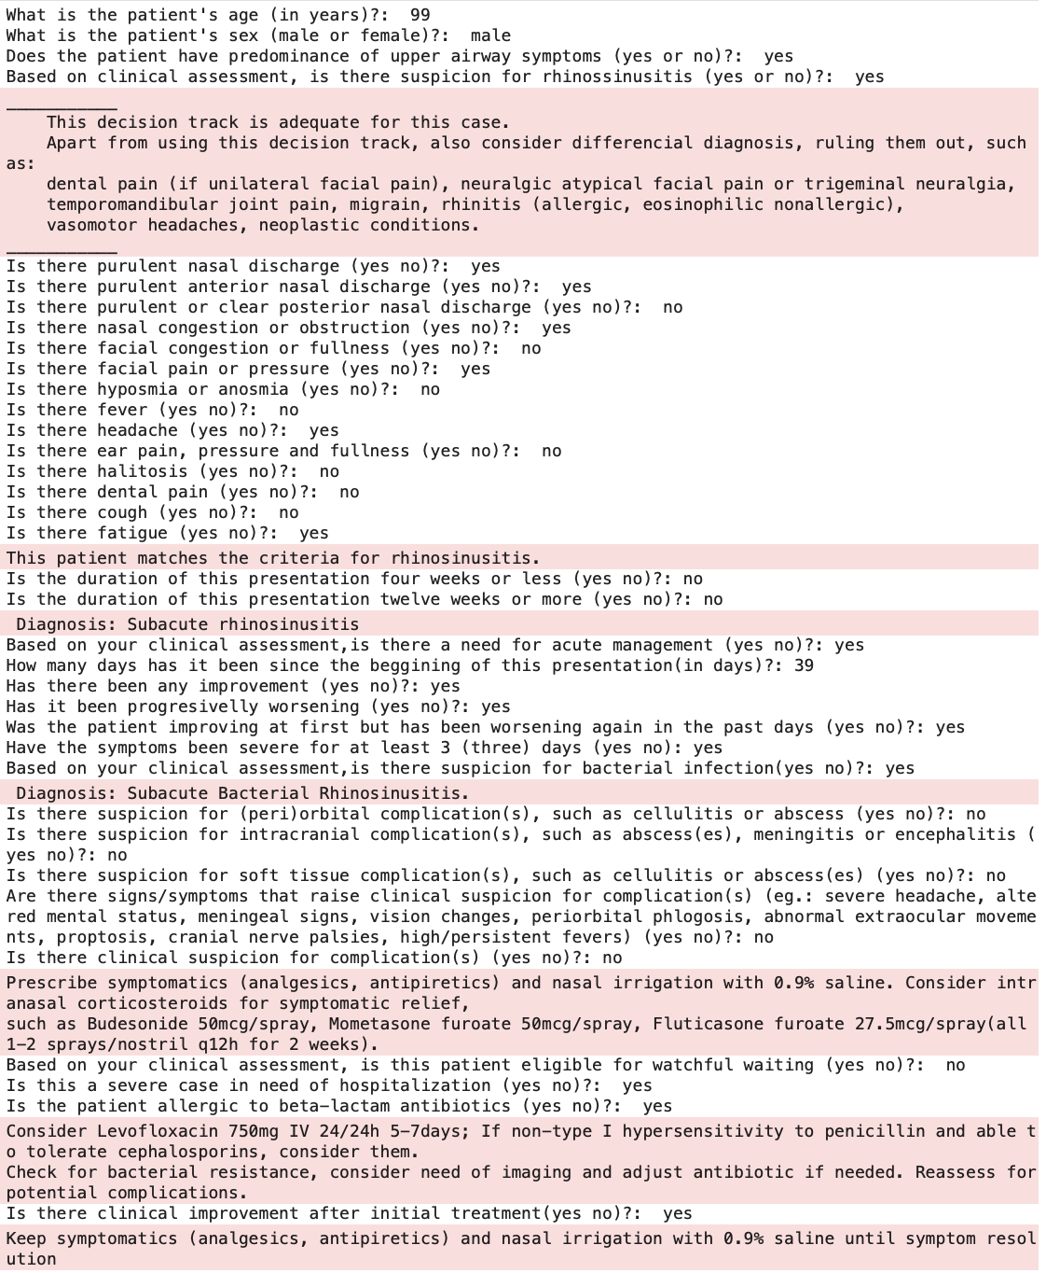
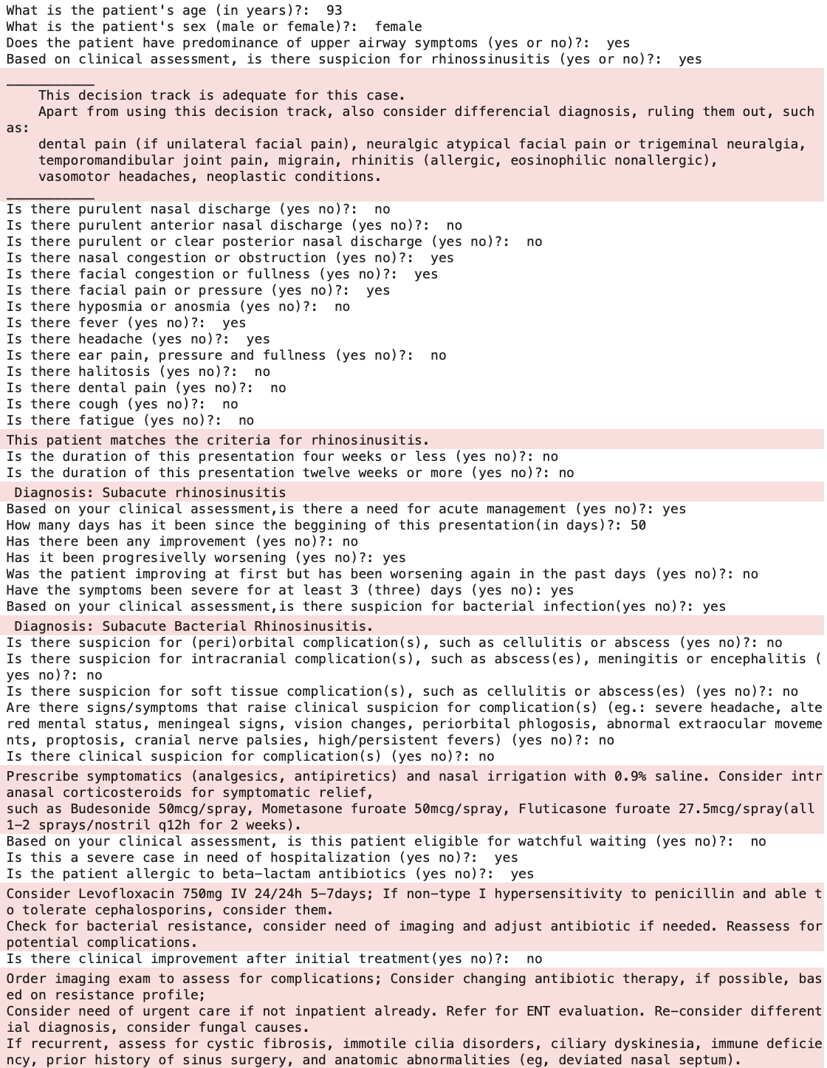
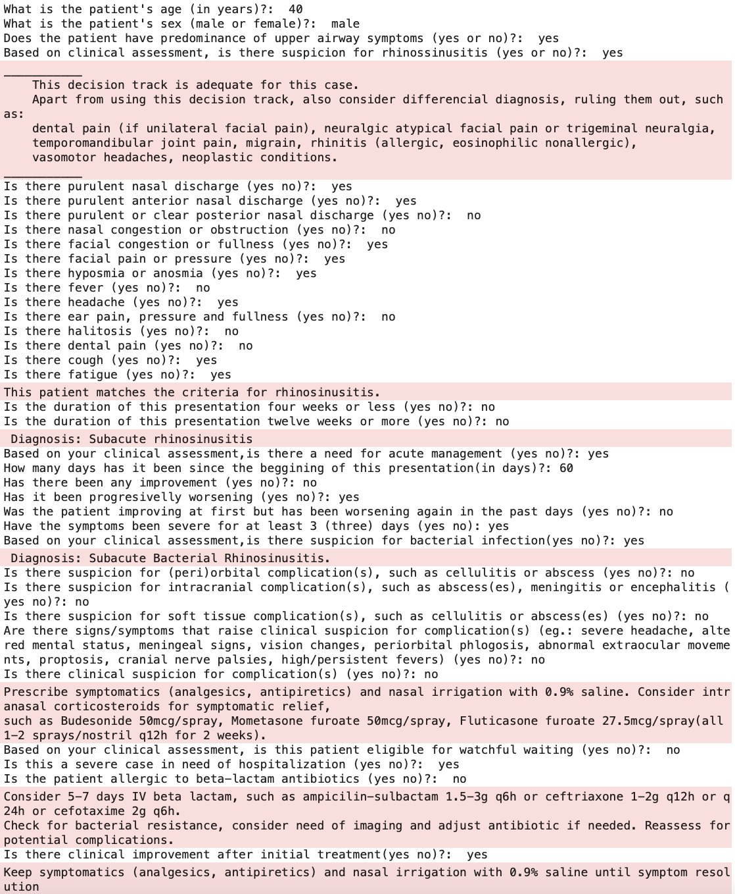
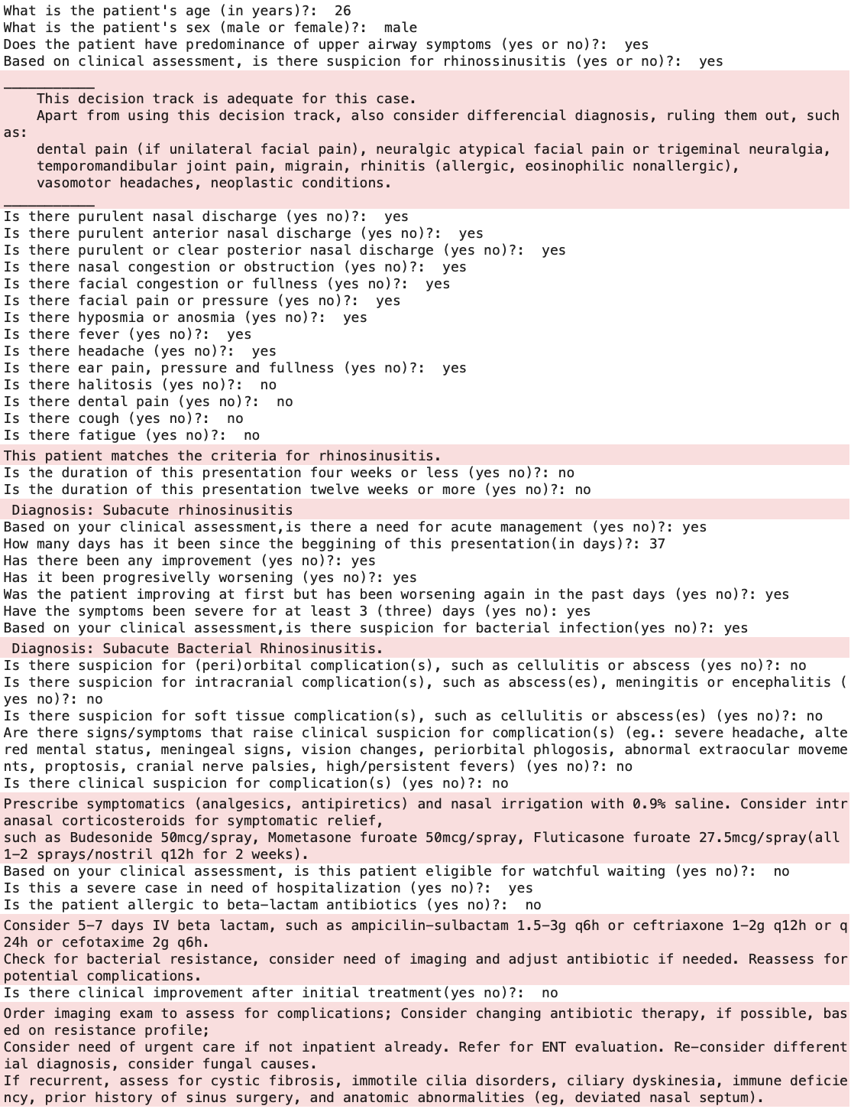
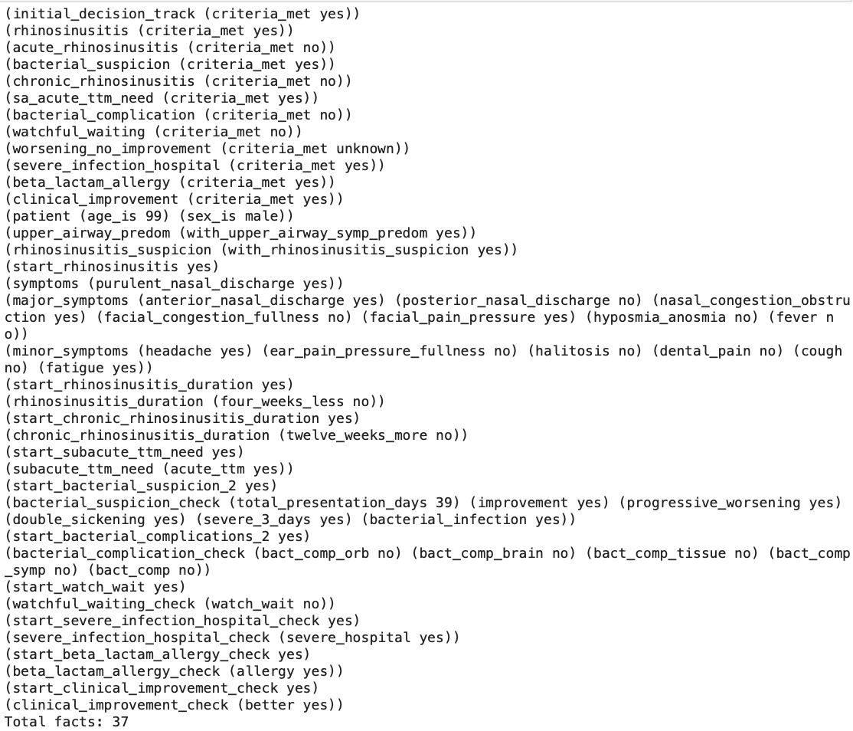



U
V
W
X
non-complicated inpatient SABRS w/ beta-lactam allergy and clinical improvement post initial treatment
non-complicated inpatient SABRS w/o beta-lactam
allergy and w/ clinical improvement post initial treatment
non-complicated inpatient SABRS w/ beta-lactam allergy
and no clinical improvement post initial treatment
non-complicated inpatient SABRS w/o beta-lactam
allergy and no clinical improvement post initial treatment
Notes:
Output examples
U: non-complicated inpatient SABRS w/ beta-lactam allergy and clinical improvement post initial treatment
V: non-complicated inpatient SABRS w/ beta-lactam allergy and no clinical improvement post initial treatment
W: non-complicated inpatient SABRS w/o beta-lactam allergy and w/ clinical improvement post initial treatment
X: non-complicated inpatient SABRS w/o beta-lactam allergy and no clinical improvement post initial treatment

Slide 9








Y
Z
A1
B1
non-complicated ABRS
watchful-waiting with improvement
non-complicated SABRS
watchful-waiting with improvement
outpatient non-complicated ABRS watchful waiting
w/o improvement w/beta-lactam allergy
w/ improvement post initial treatment
outpatient non-complicated SABRS
watchful waiting w/o improvement w/beta-lactam allergy w/ improvement post initial treatment
Notes:
Output examples:
Y: non-complicated ABRS watchful-waiting with improvement
Z: non-complicated SABRS watchful-waiting with improvement
A1: outpatient non-complicated ABRS watchful waiting w/o improvement w/beta-lactam allergy w/ improvement post initial treatment
B1: outpatient non-complicated SABRS watchful waiting w/o improvement w/beta-lactam allergy w/ improvement post initial treatment

Slide 10








C1
D1
E1
F1
outpatient non-complicated
ABRS watchful waiting
w/o improvement w/o beta-lactam allergy
w/ improvement post initial treatment
outpatient non-complicated ABRS
watchful waiting w/o improvement w/ beta-lactam
allergy w/o improvement post initial treatment
outpatient non-complicated
SABRS watchful waiting
w/o improvement w/ beta-lactam allergy
w/o improvement post initial treatment
outpatient non-complicated SABRS watchful waiting
w/o improvement w/o beta-lactam allergy
w/ improvement post initial treatment
Notes:
Output examples:
C1: outpatient non-complicated ABRS watchful waiting w/o improvement w/ beta-lactam allergy w/o improvement post initial treatment
D1: outpatient non-complicated SABRS watchful waiting w/o improvement w/ beta-lactam allergy w/o improvement post initial treatment
E1: outpatient non-complicated ABRS watchful waiting w/o improvement w/o beta-lactam allergy w/ improvement post initial treatment
F1: outpatient non-complicated SABRS watchful waiting w/o improvement w/o beta-lactam allergy w/ improvement post initial treatment

Slide 11









G1
H1
I1
J1
outpatient non-complicated ABRS watchful waiting w/o improvement
w/o beta-lactam allergy
w/o improvement post initial treatment
outpatient non-complicated SABRS
watchful waiting w/o improvement
w/o beta-lactam allergy
w/o improvement post initial treatment
inpatient non-complicated ABRS watchful waiting
w/o improvement w/beta-lactam allergy
w/ improvement post initial treatment
inpatient non-complicated SABRS
watchful waiting w/o improvement w/beta-lactam allergy
w/ improvement post initial treatment
Notes:
Output examples: G1:outpatient non-complicated ABRS watchful waiting w/o improvement w/o beta-lactam allergy w/o improvement post initial treatment
H1: outpatient non-complicated SABRS watchful waiting w/o improvement w/o beta-lactam allergy w/o improvement post initial treatment
I1: inpatient non-complicated ABRS watchful waiting w/o improvement w/beta-lactam allergy w/ improvement post initial treatment
J1: inpatient non-complicated SABRS watchful waiting w/o improvement w/beta-lactam allergy w/ improvement post initial treatment

Slide 12








K1
L1
M1
N1
inpatient non-complicated ABRS watchful waiting
w/o improvement w/o beta-lactam allergy
w/ improvement post initial treatment
inpatient non-complicated ABRS watchful waiting
w/o improvement w/ beta-lactam allergy
w/o improvement post initial treatment
inpatient non-complicated SABRS watchful waiting
w/o improvement w/ beta-lactam allergy
w/o improvement post initial treatment
inpatient non-complicated SABRS watchful waiting
w/o improvement w/o beta-lactam allergy
w/ improvement post initial treatment
Notes:
Output examples:
K1: inpatient non-complicated ABRS watchful waiting w/o improvement w/ beta-lactam allergyw/o improvement post initial treatment
L1: inpatient non-complicated SABRS watchful waiting w/o improvement w/ beta-lactam allergy w/o improvement post initial treatment
M1: inpatient non-complicated ABRS watchful waiting w/o improvement w/o beta-lactam allergy w/ improvement post initial treatment
N1: inpatient non-complicated SABRS watchful waiting w/o improvement w/o beta-lactam allergy w/ improvement post initial treatment

Slide 13




O1
P1
inpatient non-complicated ABRS watchful waiting
w/o improvement w/o beta-lactam allergy
w/o improvement post initial treatment
inpatient non-complicated SABRS watchful waiting
w/o improvement w/o beta-lactam allergy
w/o improvement post initial treatment
Notes:
Output examples:
O1: inpatient non-complicated ABRS watchful waiting w/o improvement w/o beta-lactam allergy w/o improvement post initial treatment
P1: inpatient non-complicated SABRS watchful waiting w/o improvement w/o beta-lactam allergy w/o improvement post initial treatment

